Slide 1
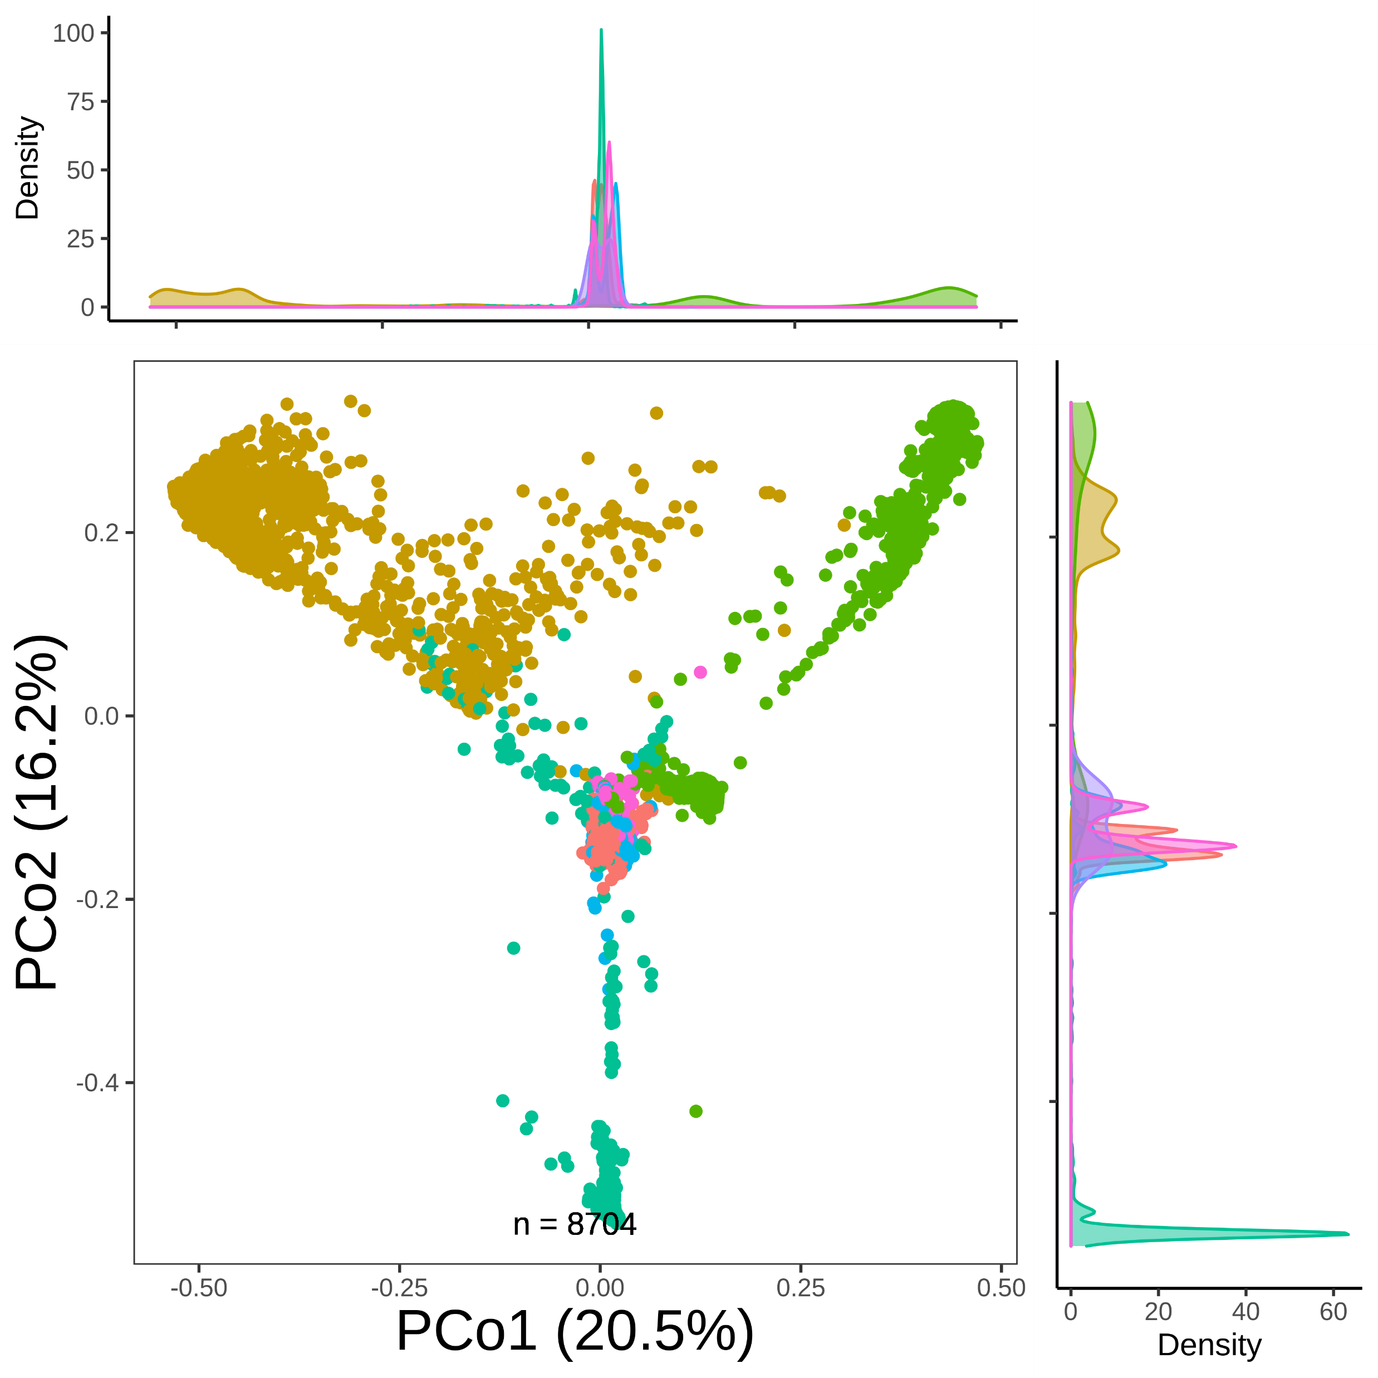
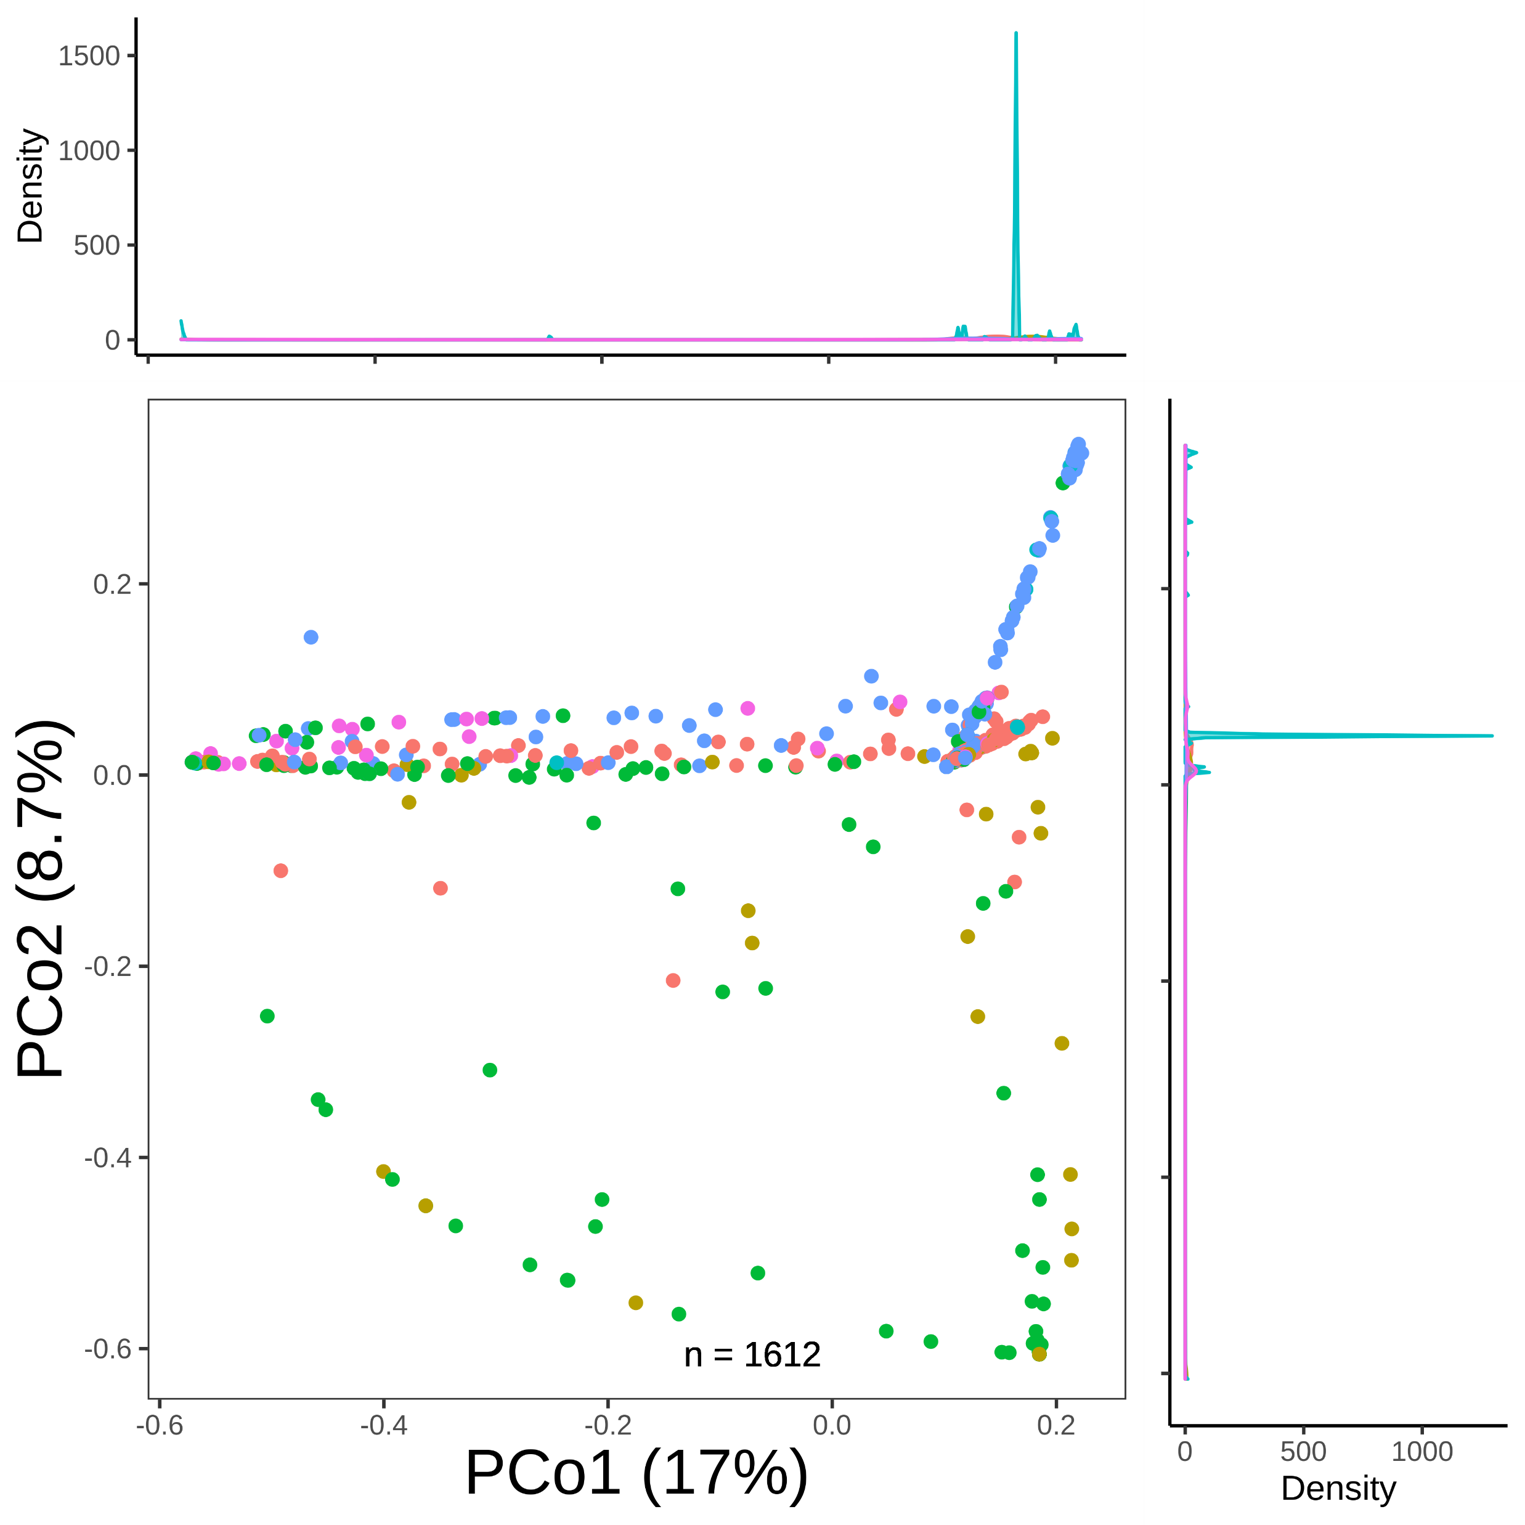
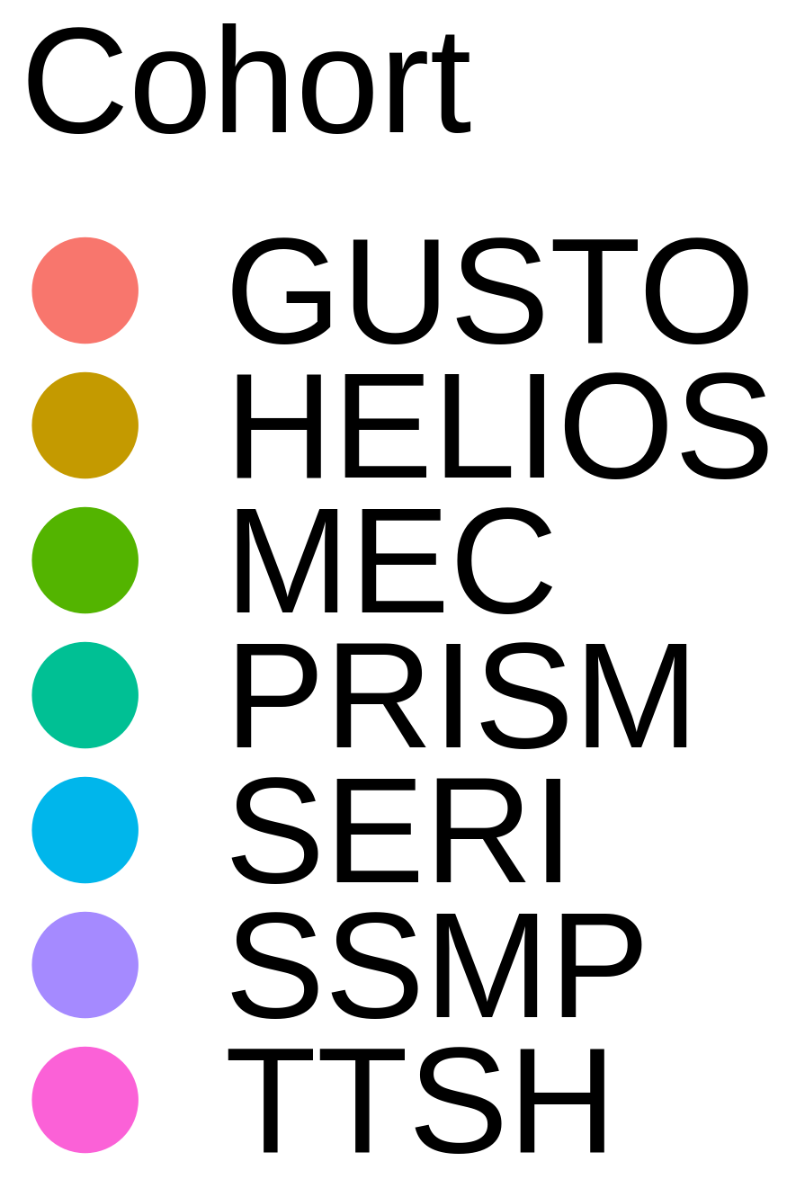
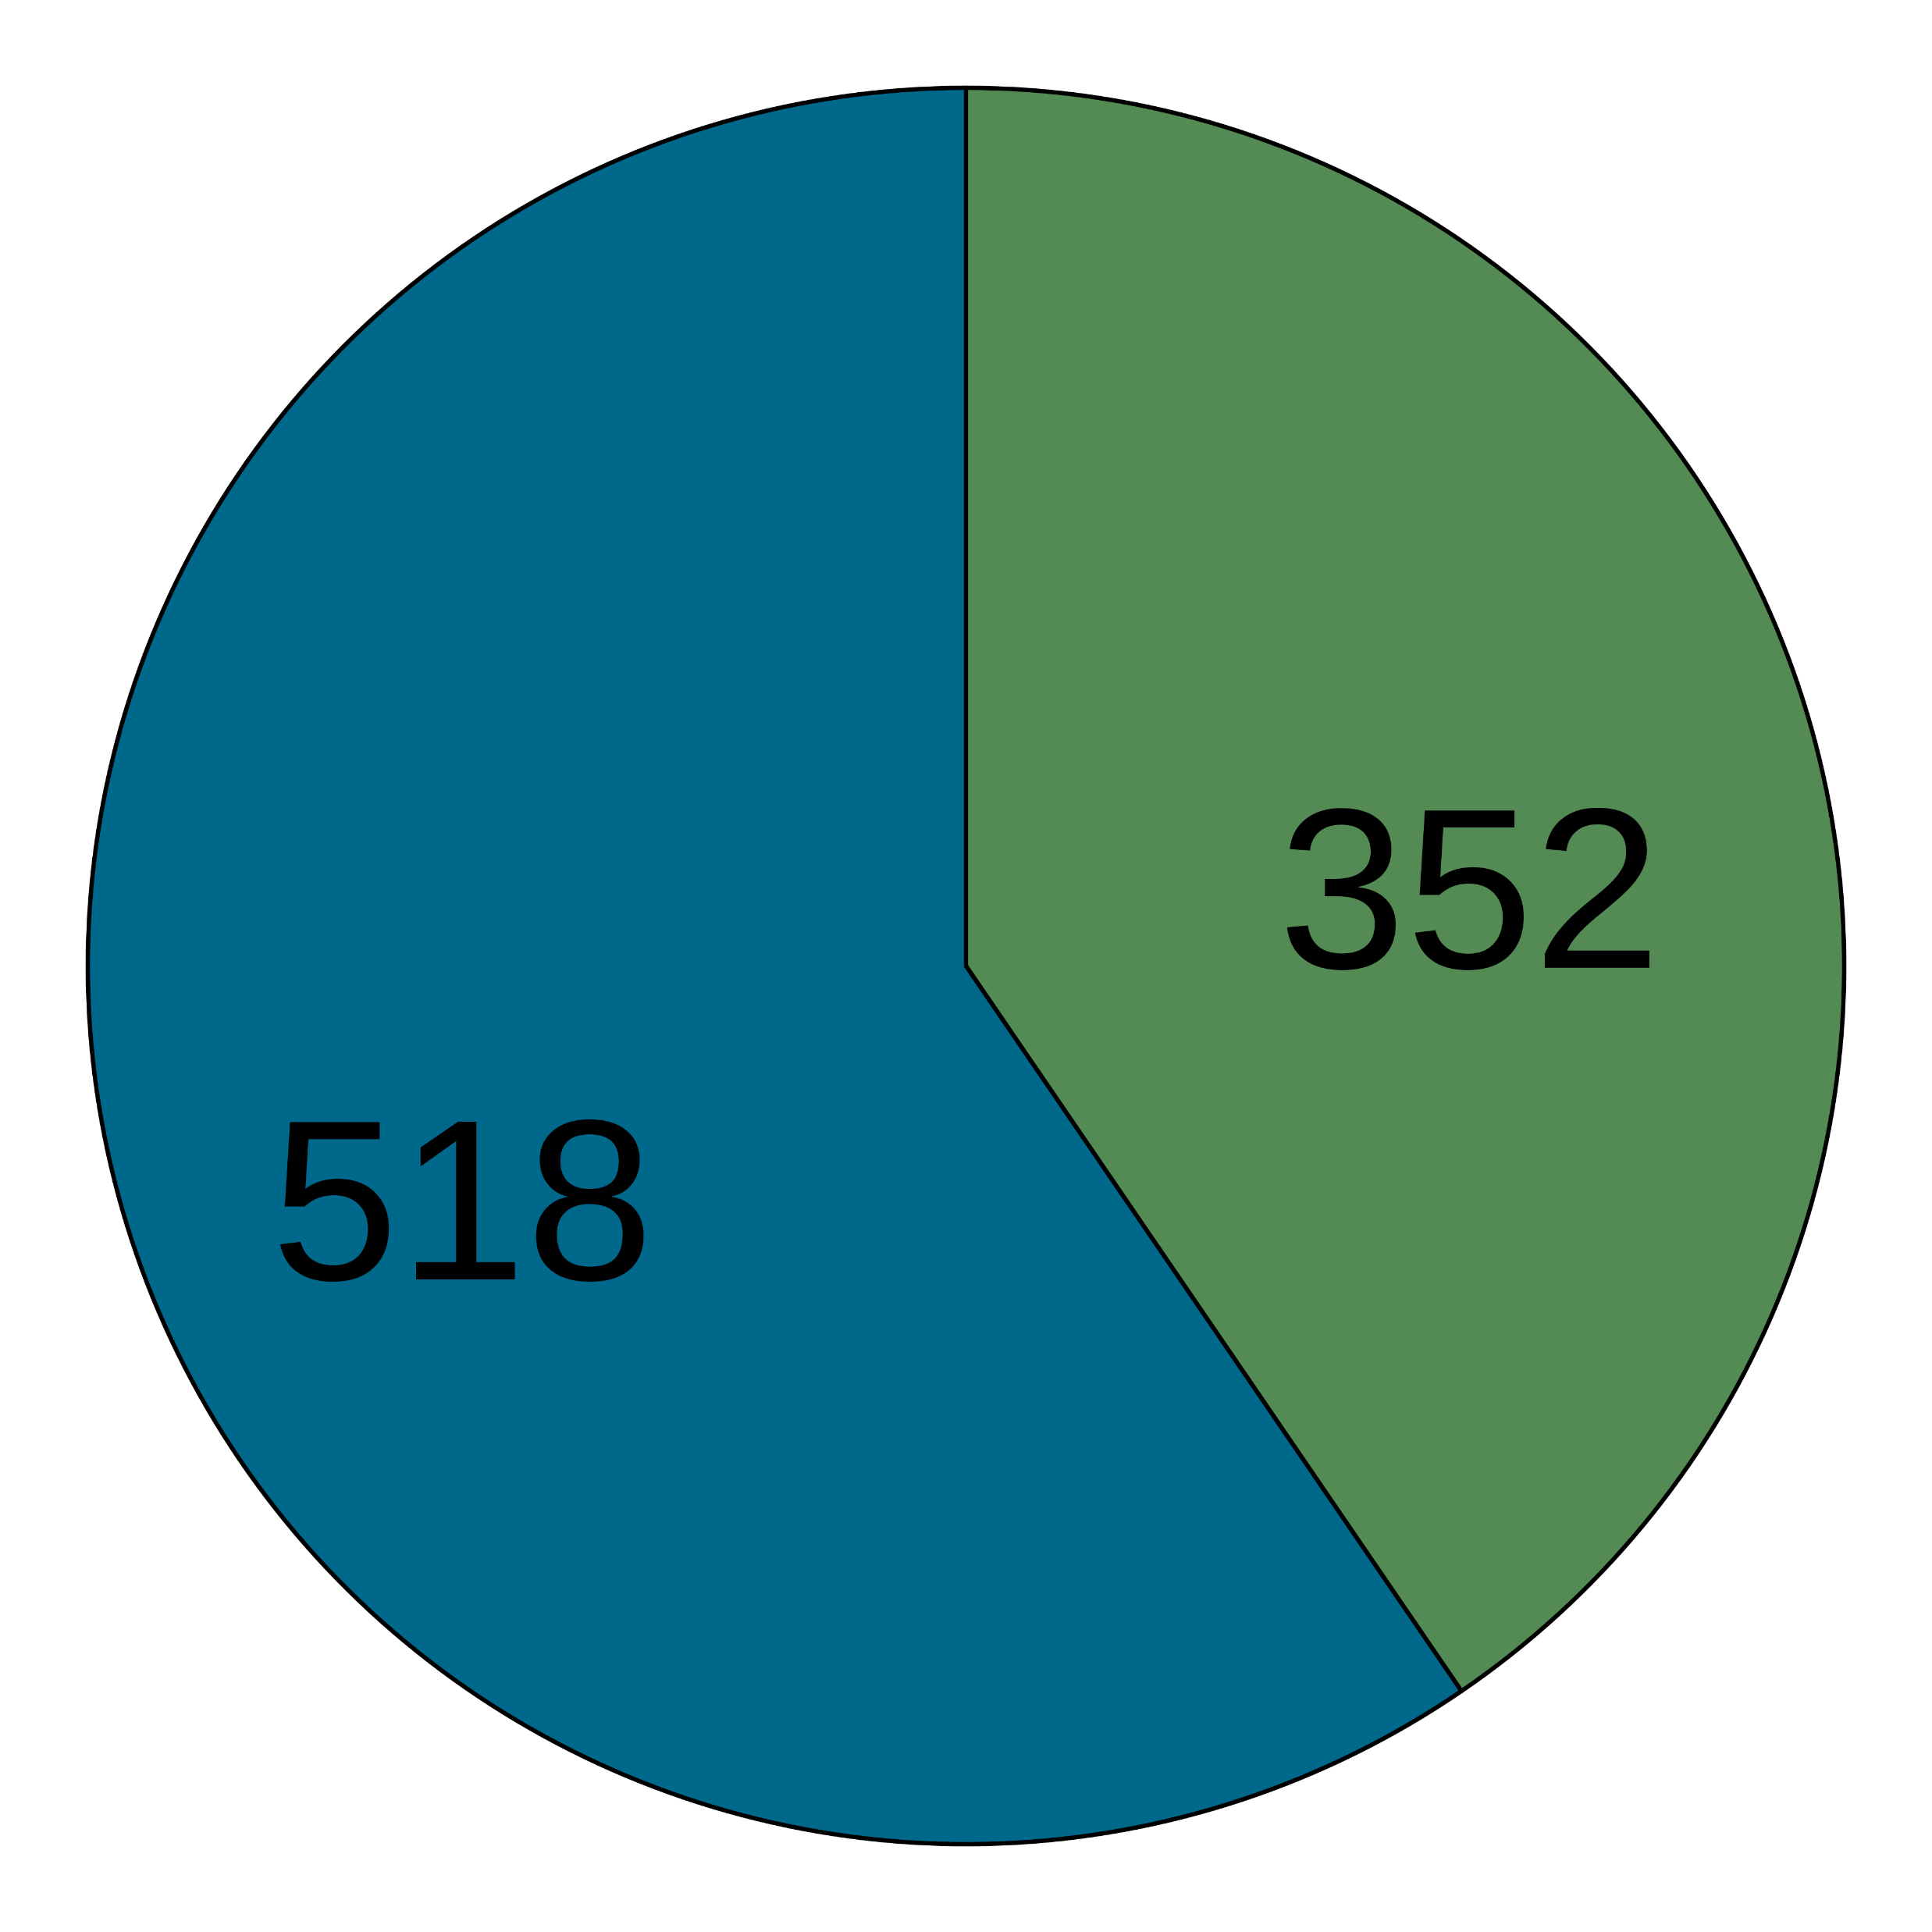
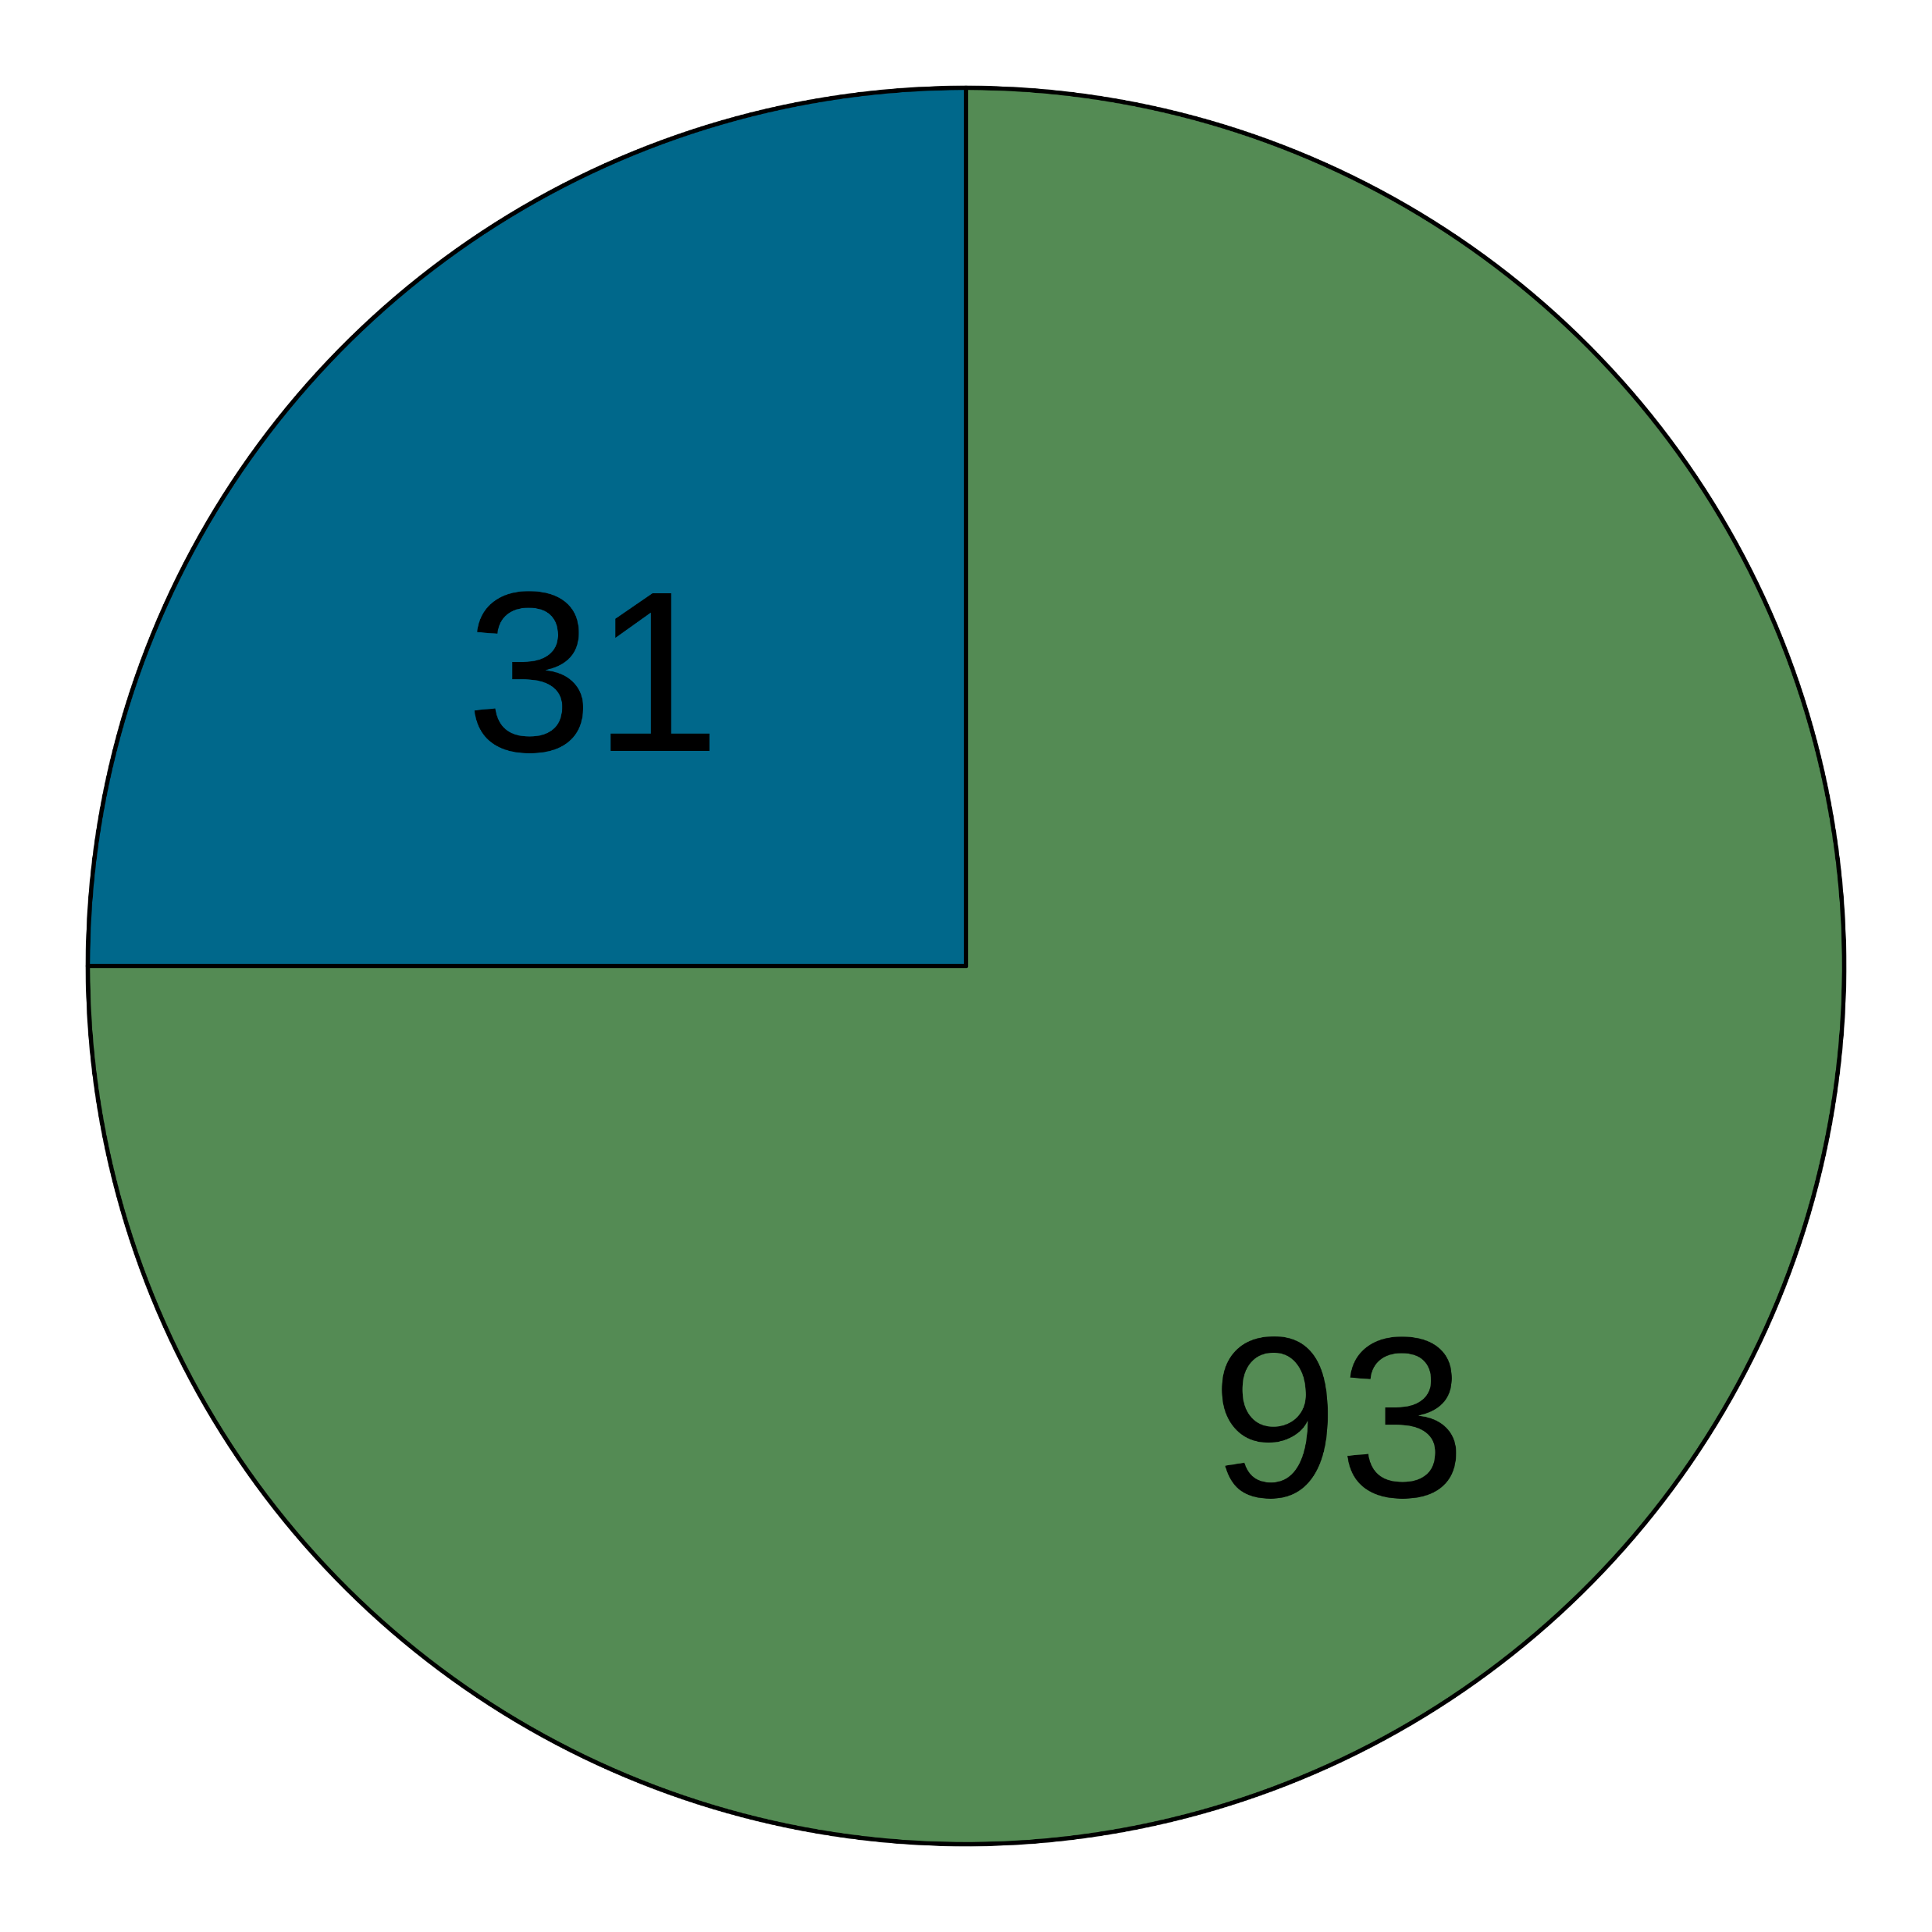
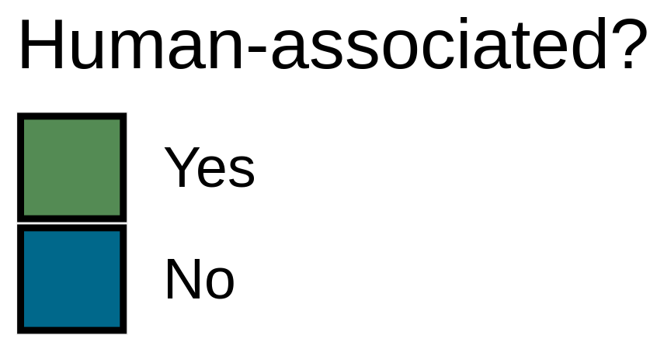
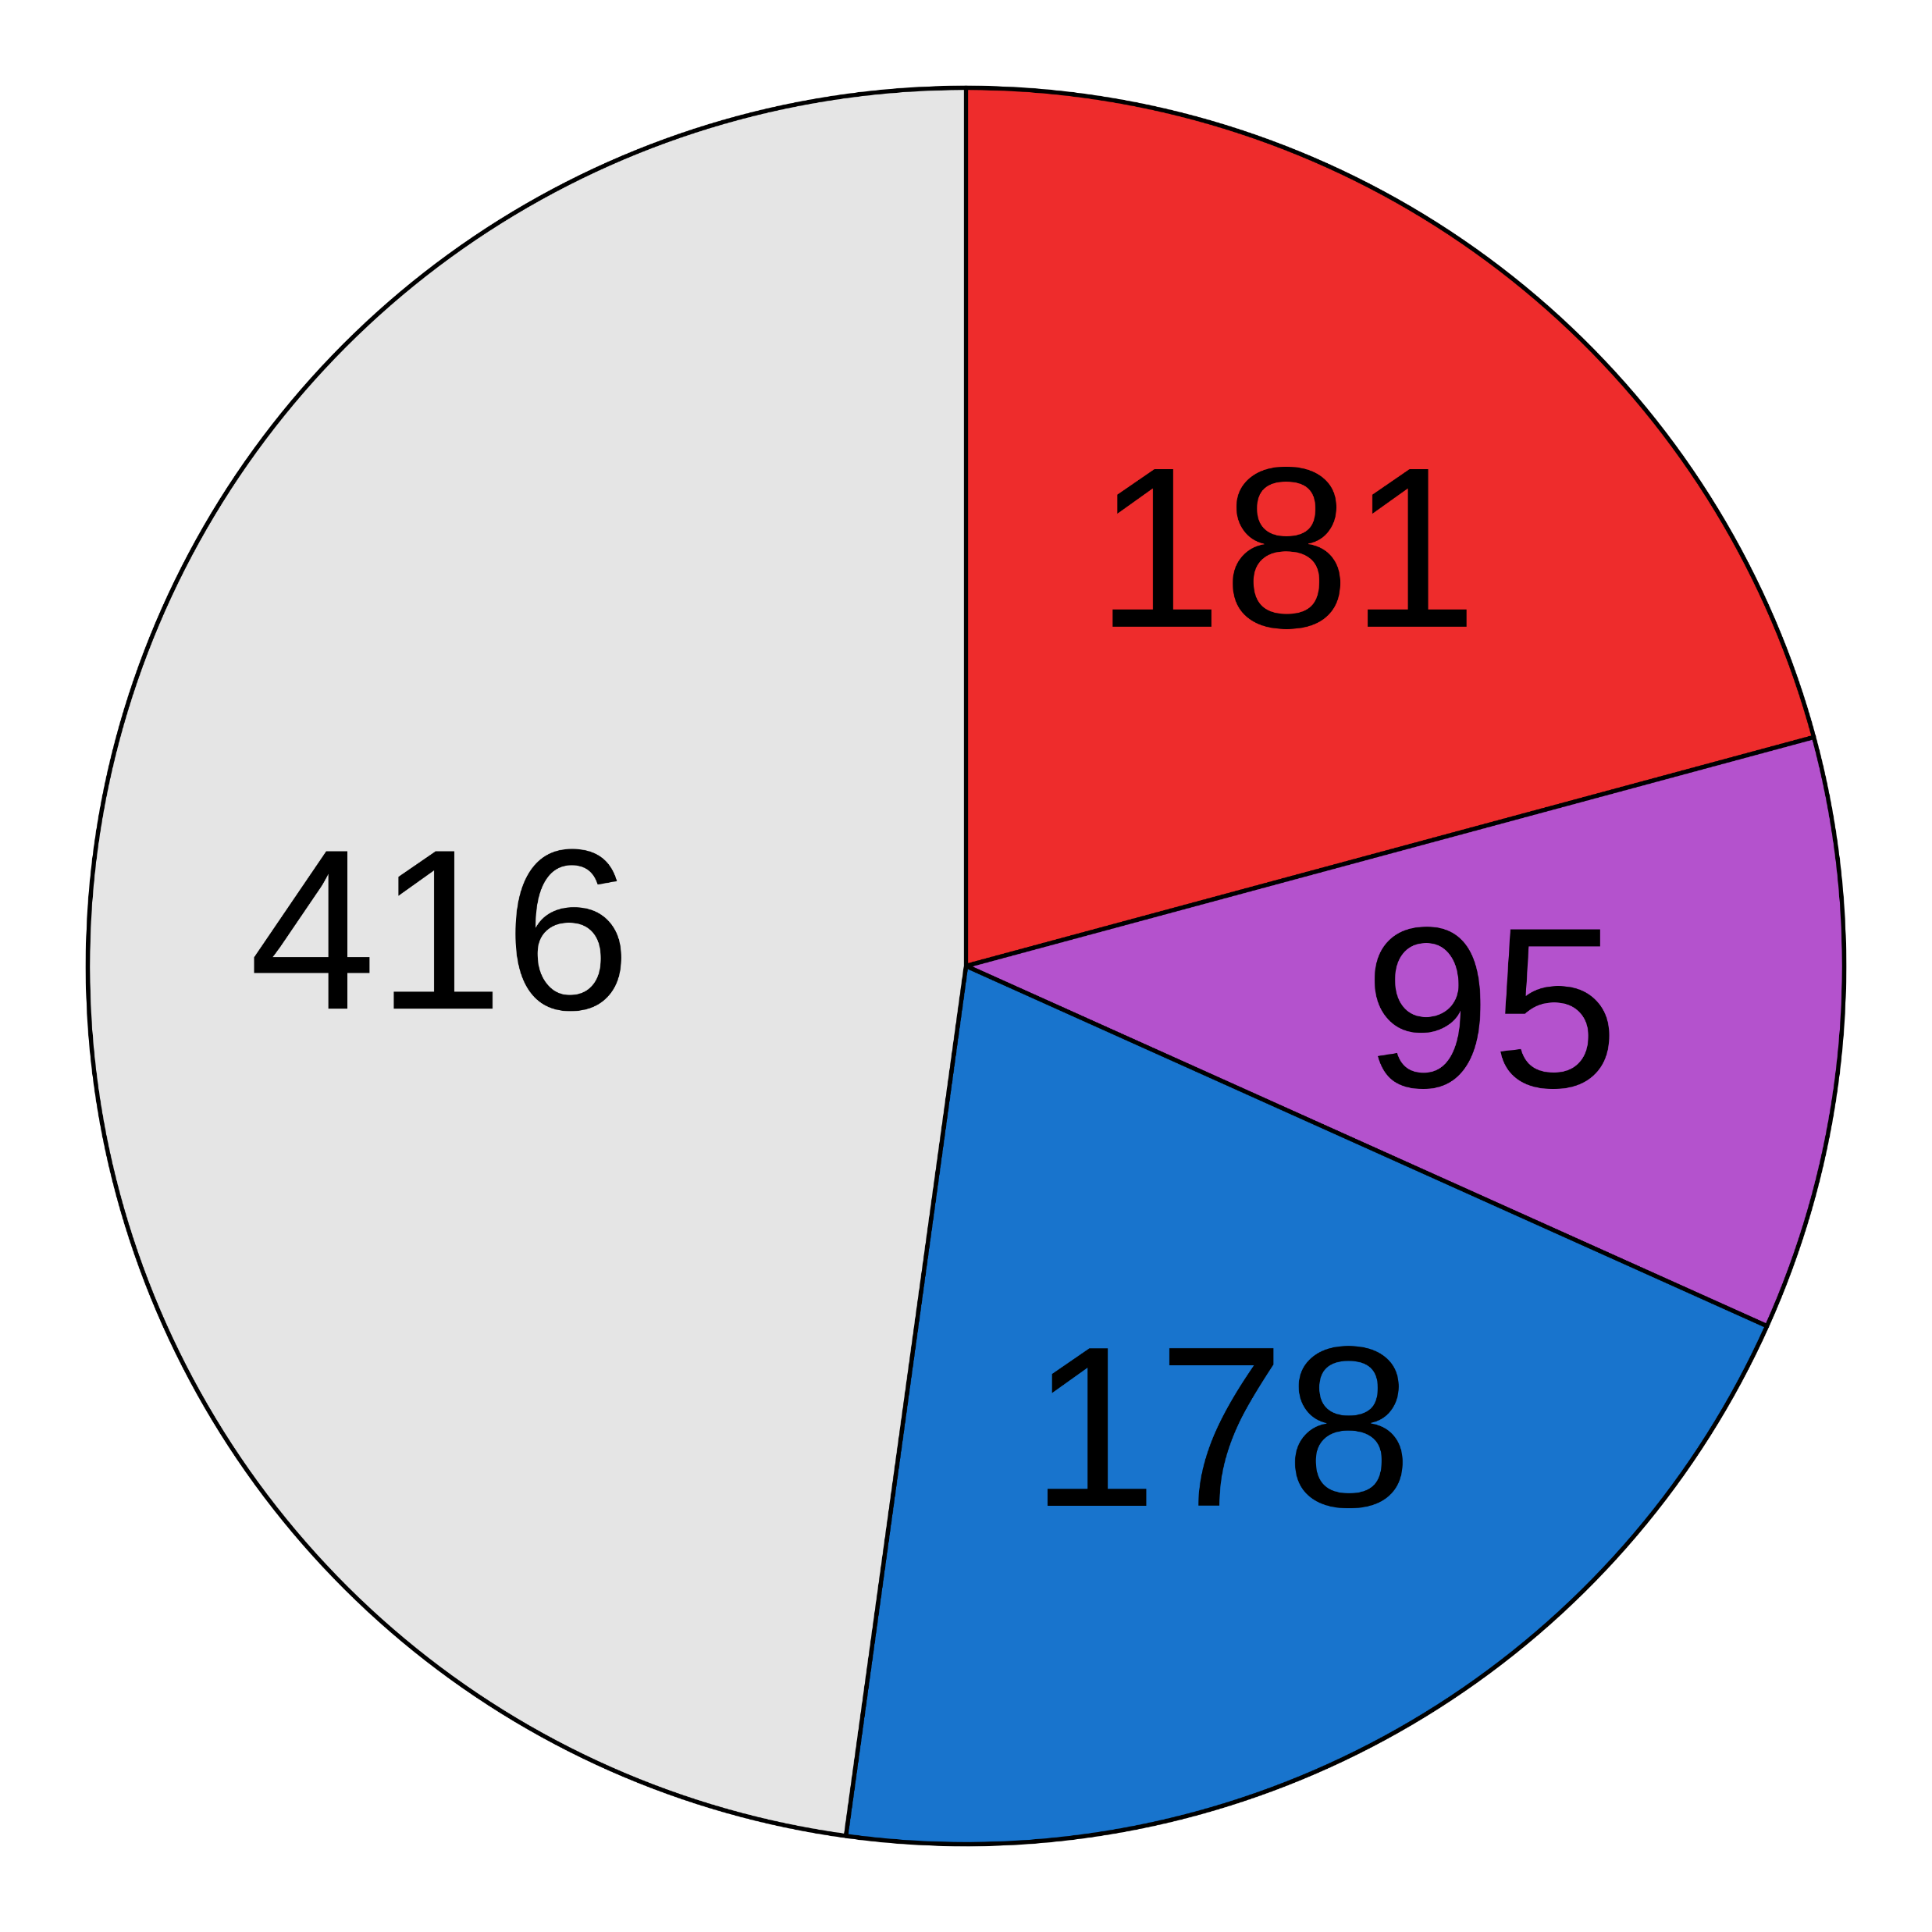
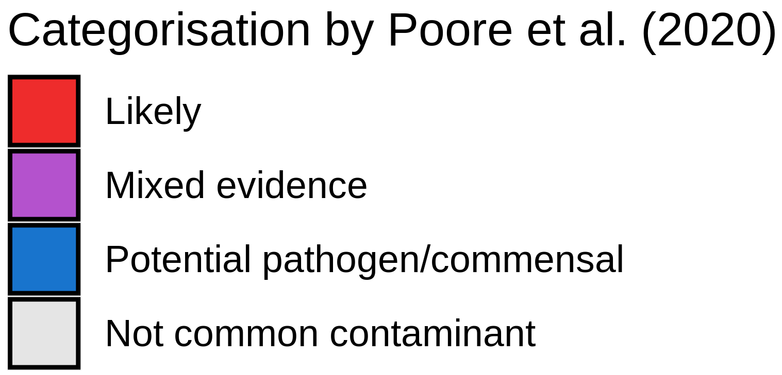
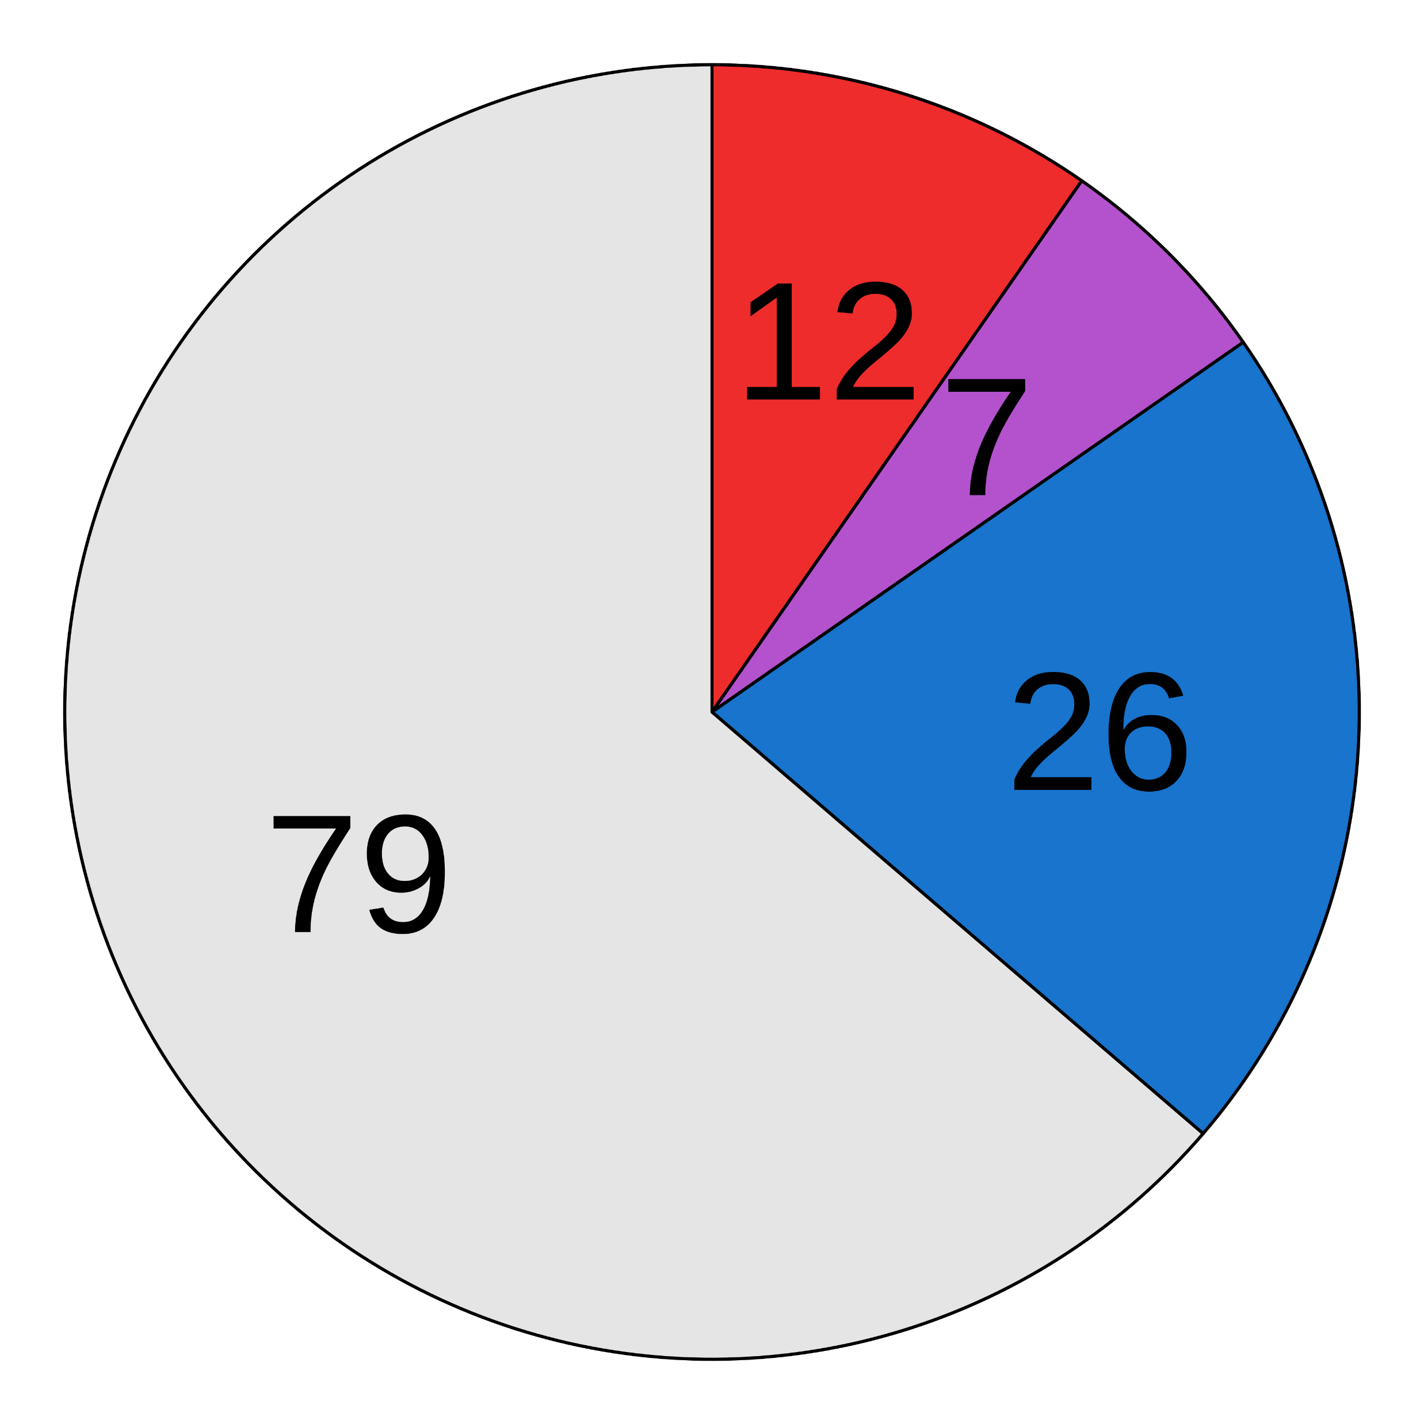
(a)
Pre-processed fastqs (n = 8828)
Kraken2 classification
Apply abundance thresholds
8841 species
871 species
Filter 1
Filter 2
Filter 3
Filter 4
Differential prevalence
Correlation
Batch filter
Read count filter
Downstream analyses
710 species
535 species
190 species
124 species
(b)
Before decontamination
After decontamination
(c)
(d)
(e)
Detected in blood cultures?
TBC
TBC
Notes:
Figure 1 → convince reader that I have eliminated most sources of error
Include sample sizes
Simplify filter descriptions (2-3 words)
BC records frequently/rarely
Stratification of culture reason

Slide 2
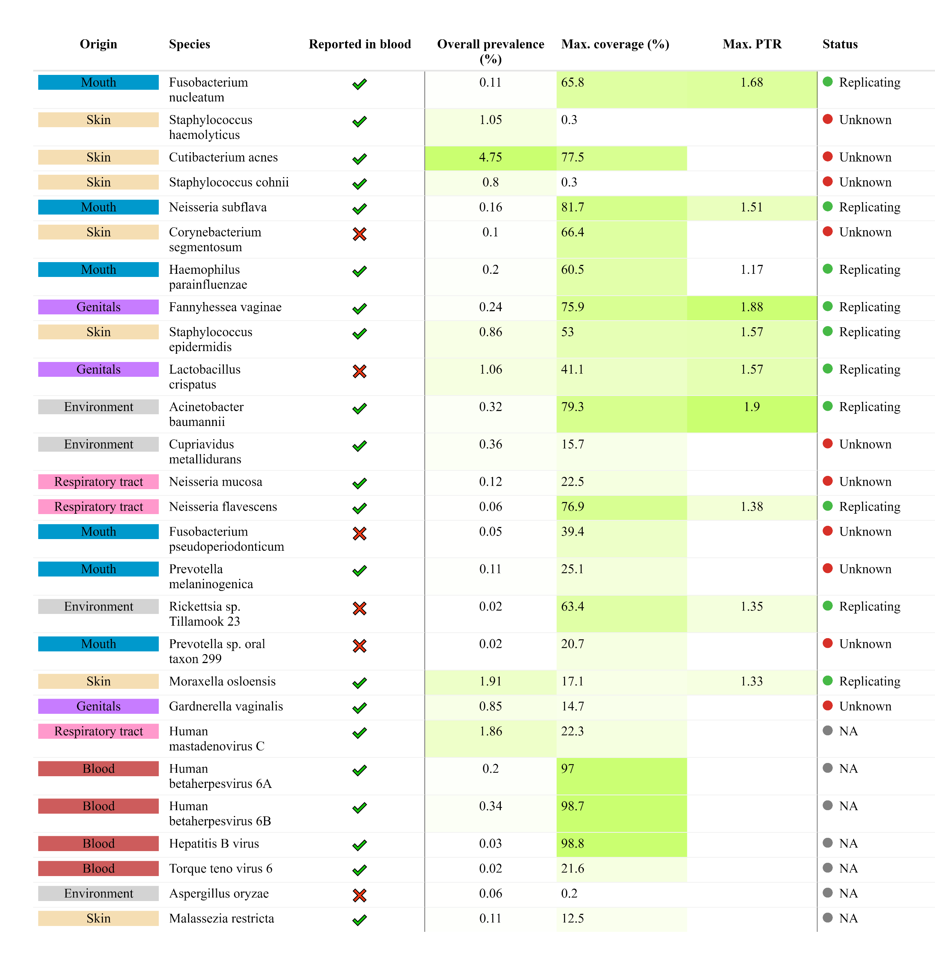



Notes:
Figure 2
Check blood transfusion literature
Max. number of cells for contaminants vs. nc
Compare ranks of BC records with our ranks
Add average relative abundance

Slide 3
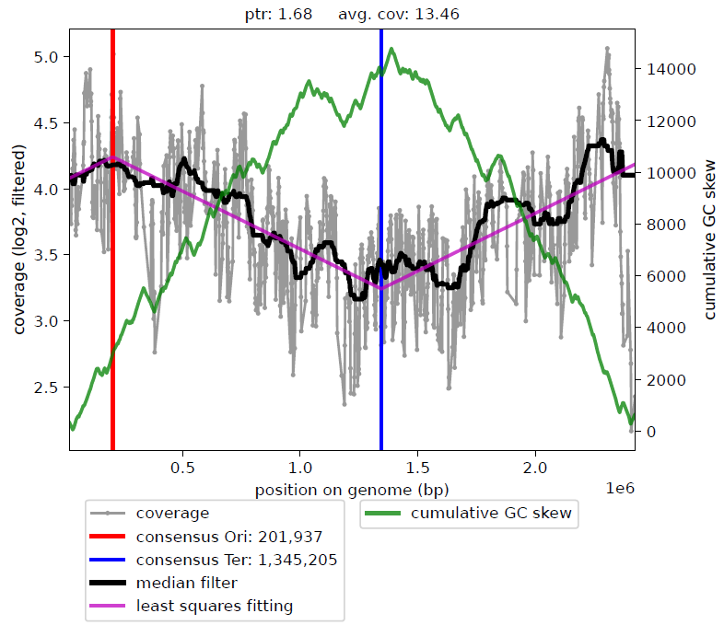
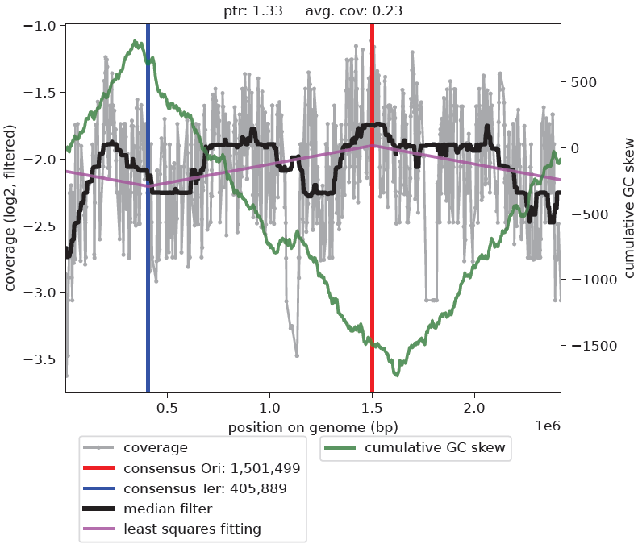
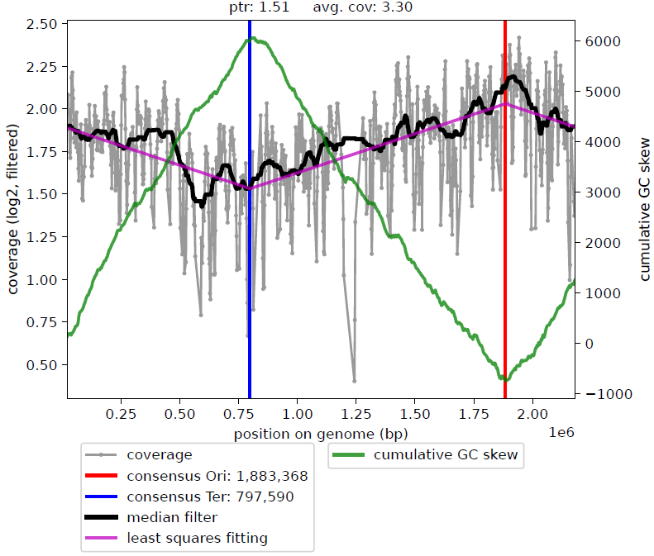
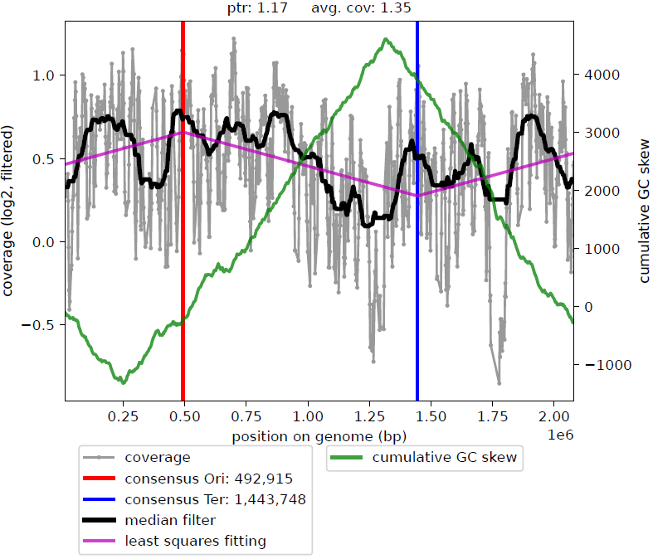
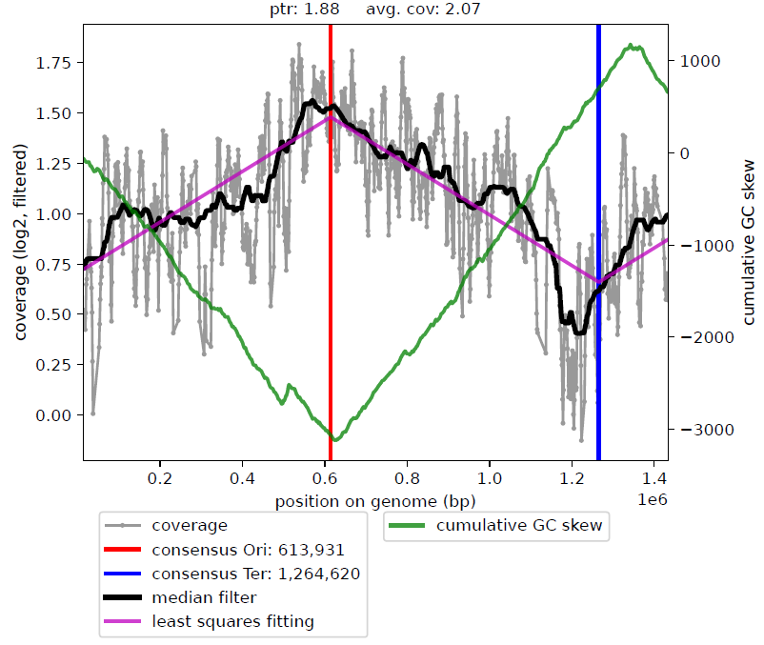
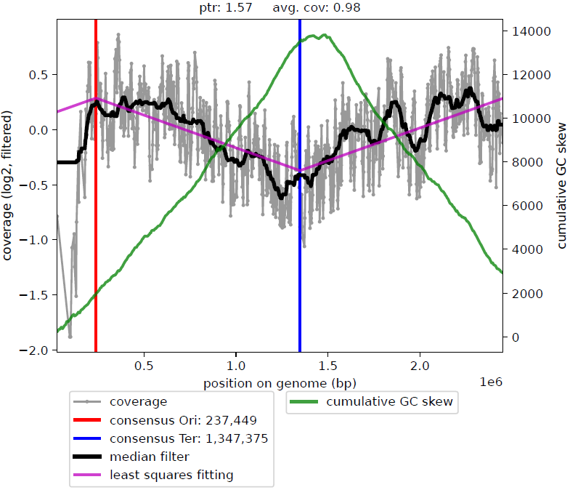
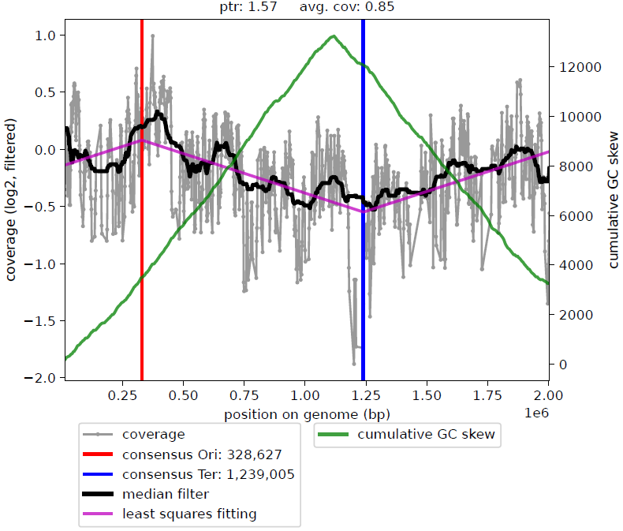
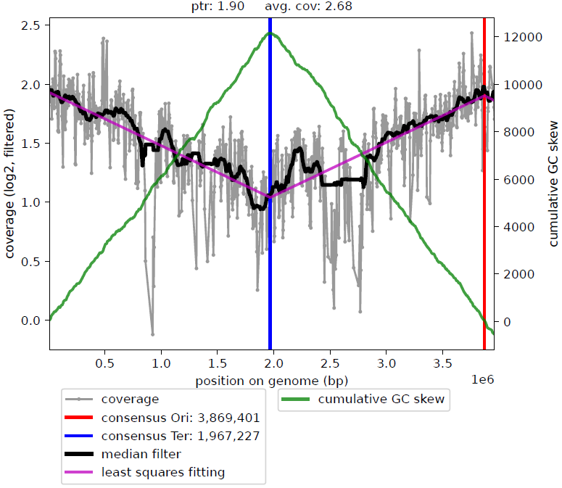
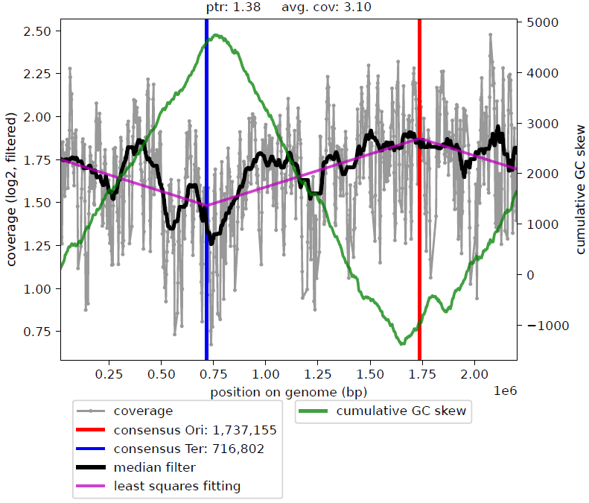
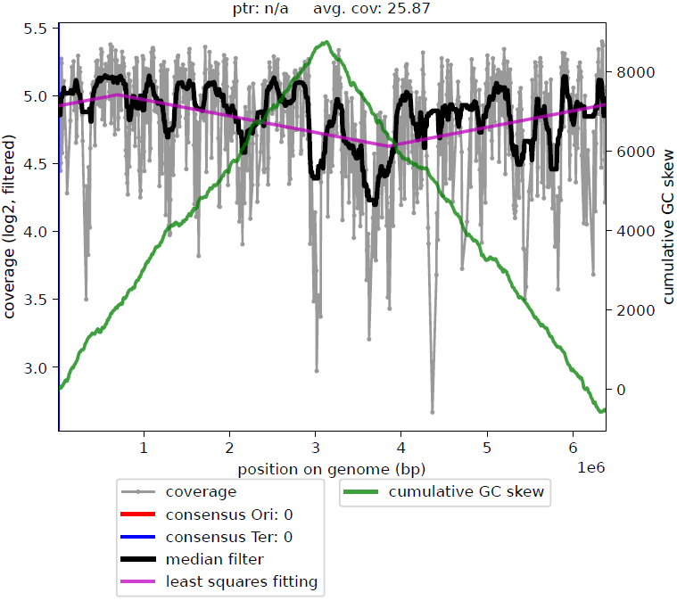
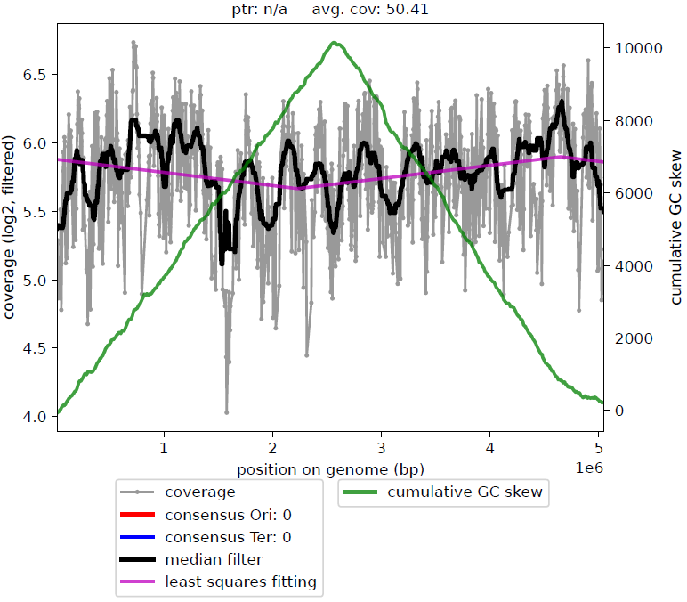
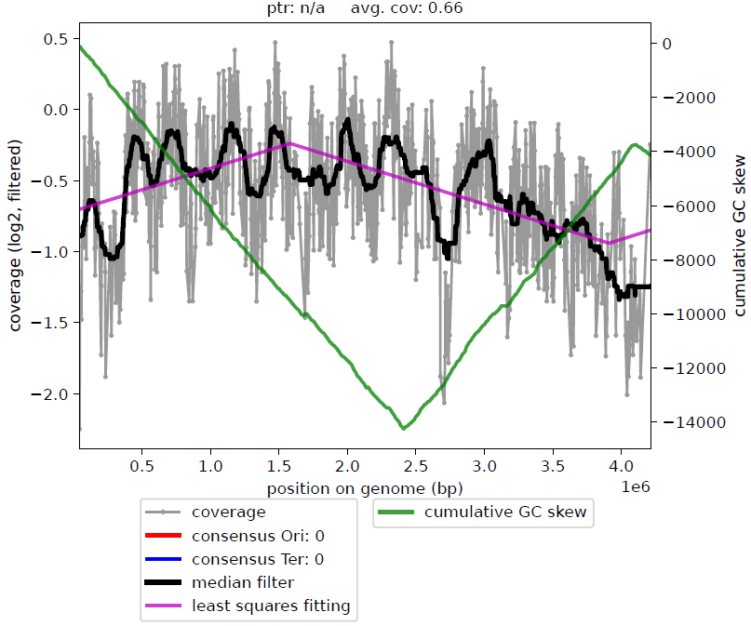
(a)
Non-contaminants
F. nucleatum
M. osloensis
M. osloensis
N. subflava
H. parainfluenzae
F. vaginae
S. epidermidis
L. crispatus
A. baumannii
N. flavescens
(b)
Contaminants
A. xylosoxidans
P. mendocina
A. faecalis
Notes:
Figure 3 GROUPED
Median smoothing
Multiplot this (2x2)
We have helios skin data

Slide 4
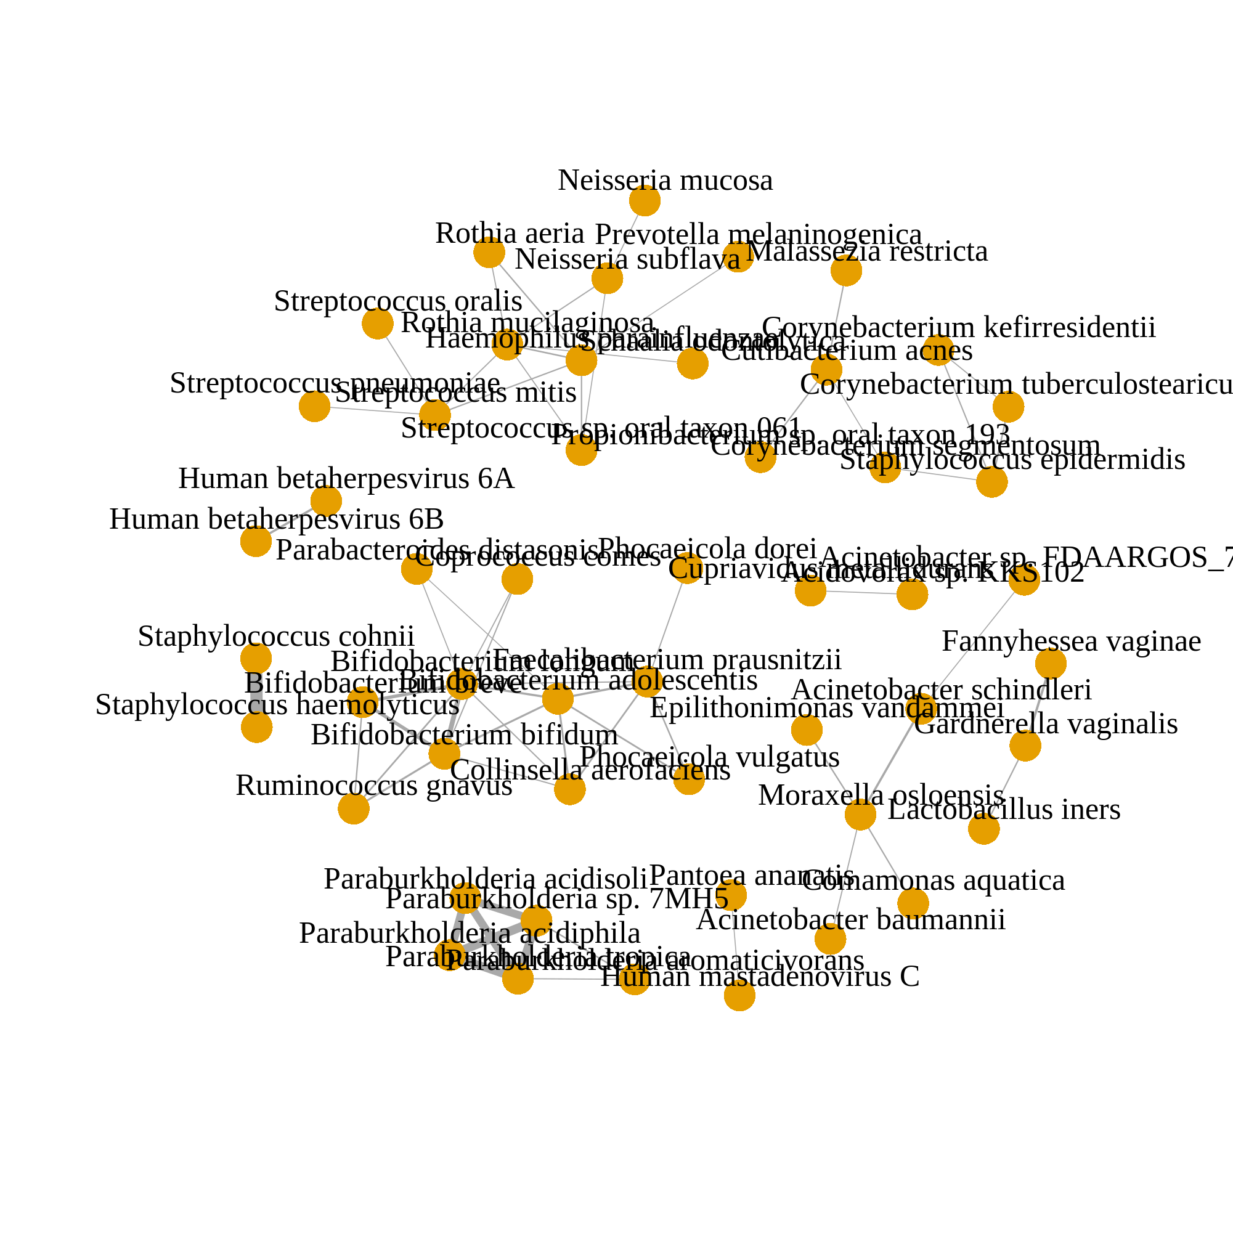
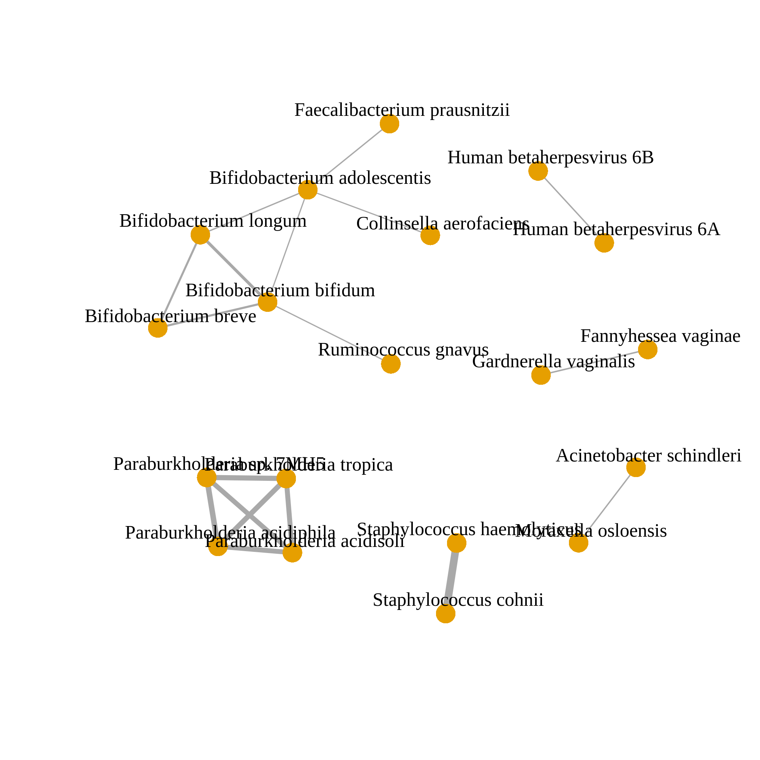
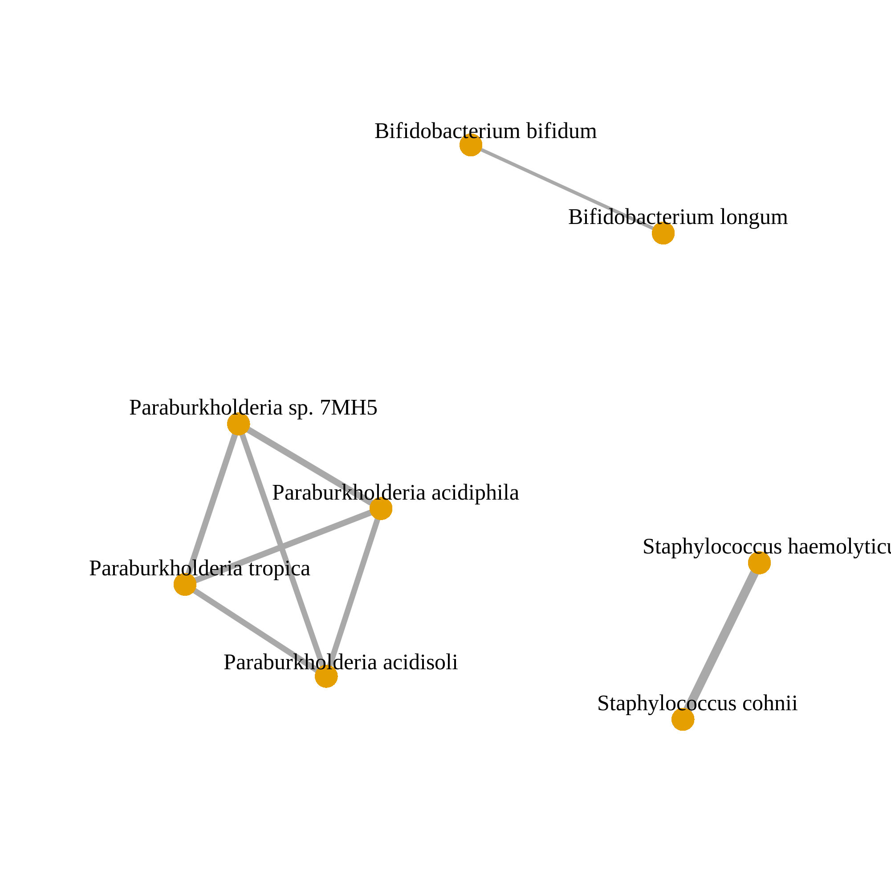
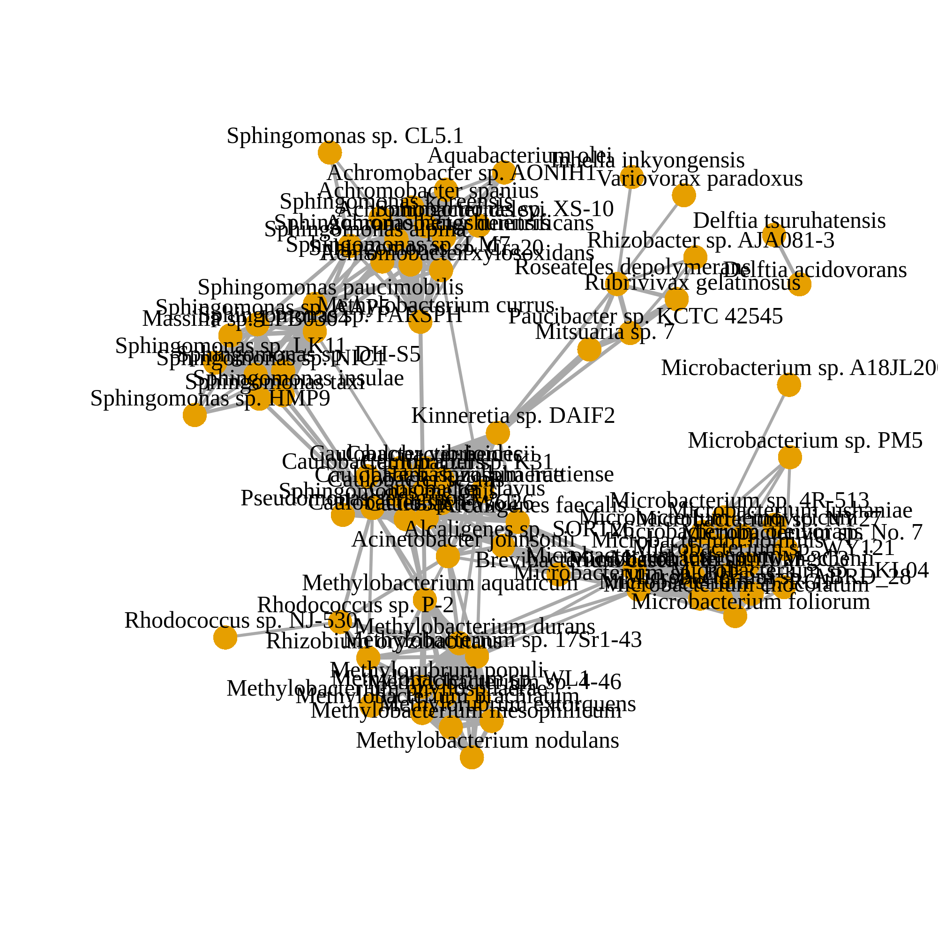
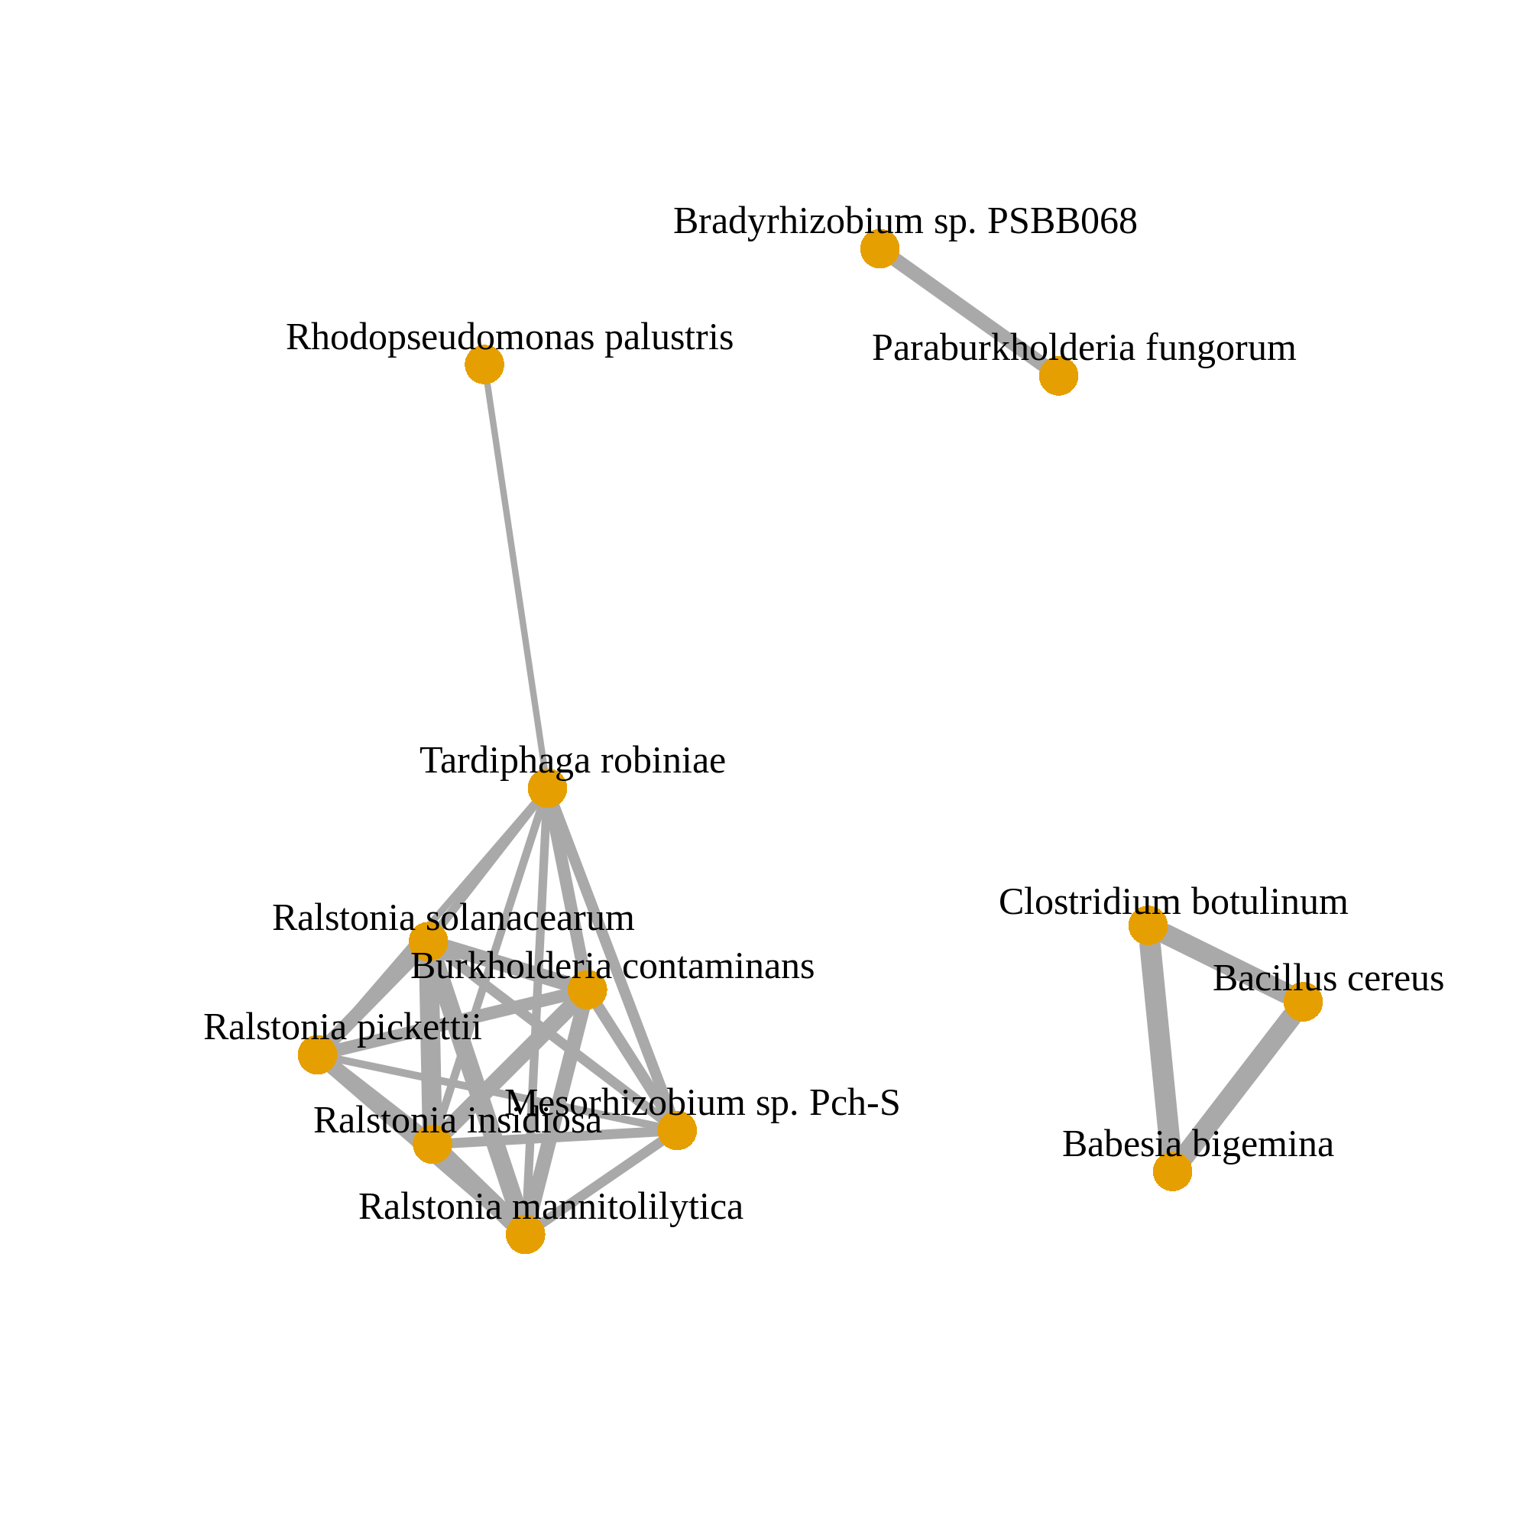
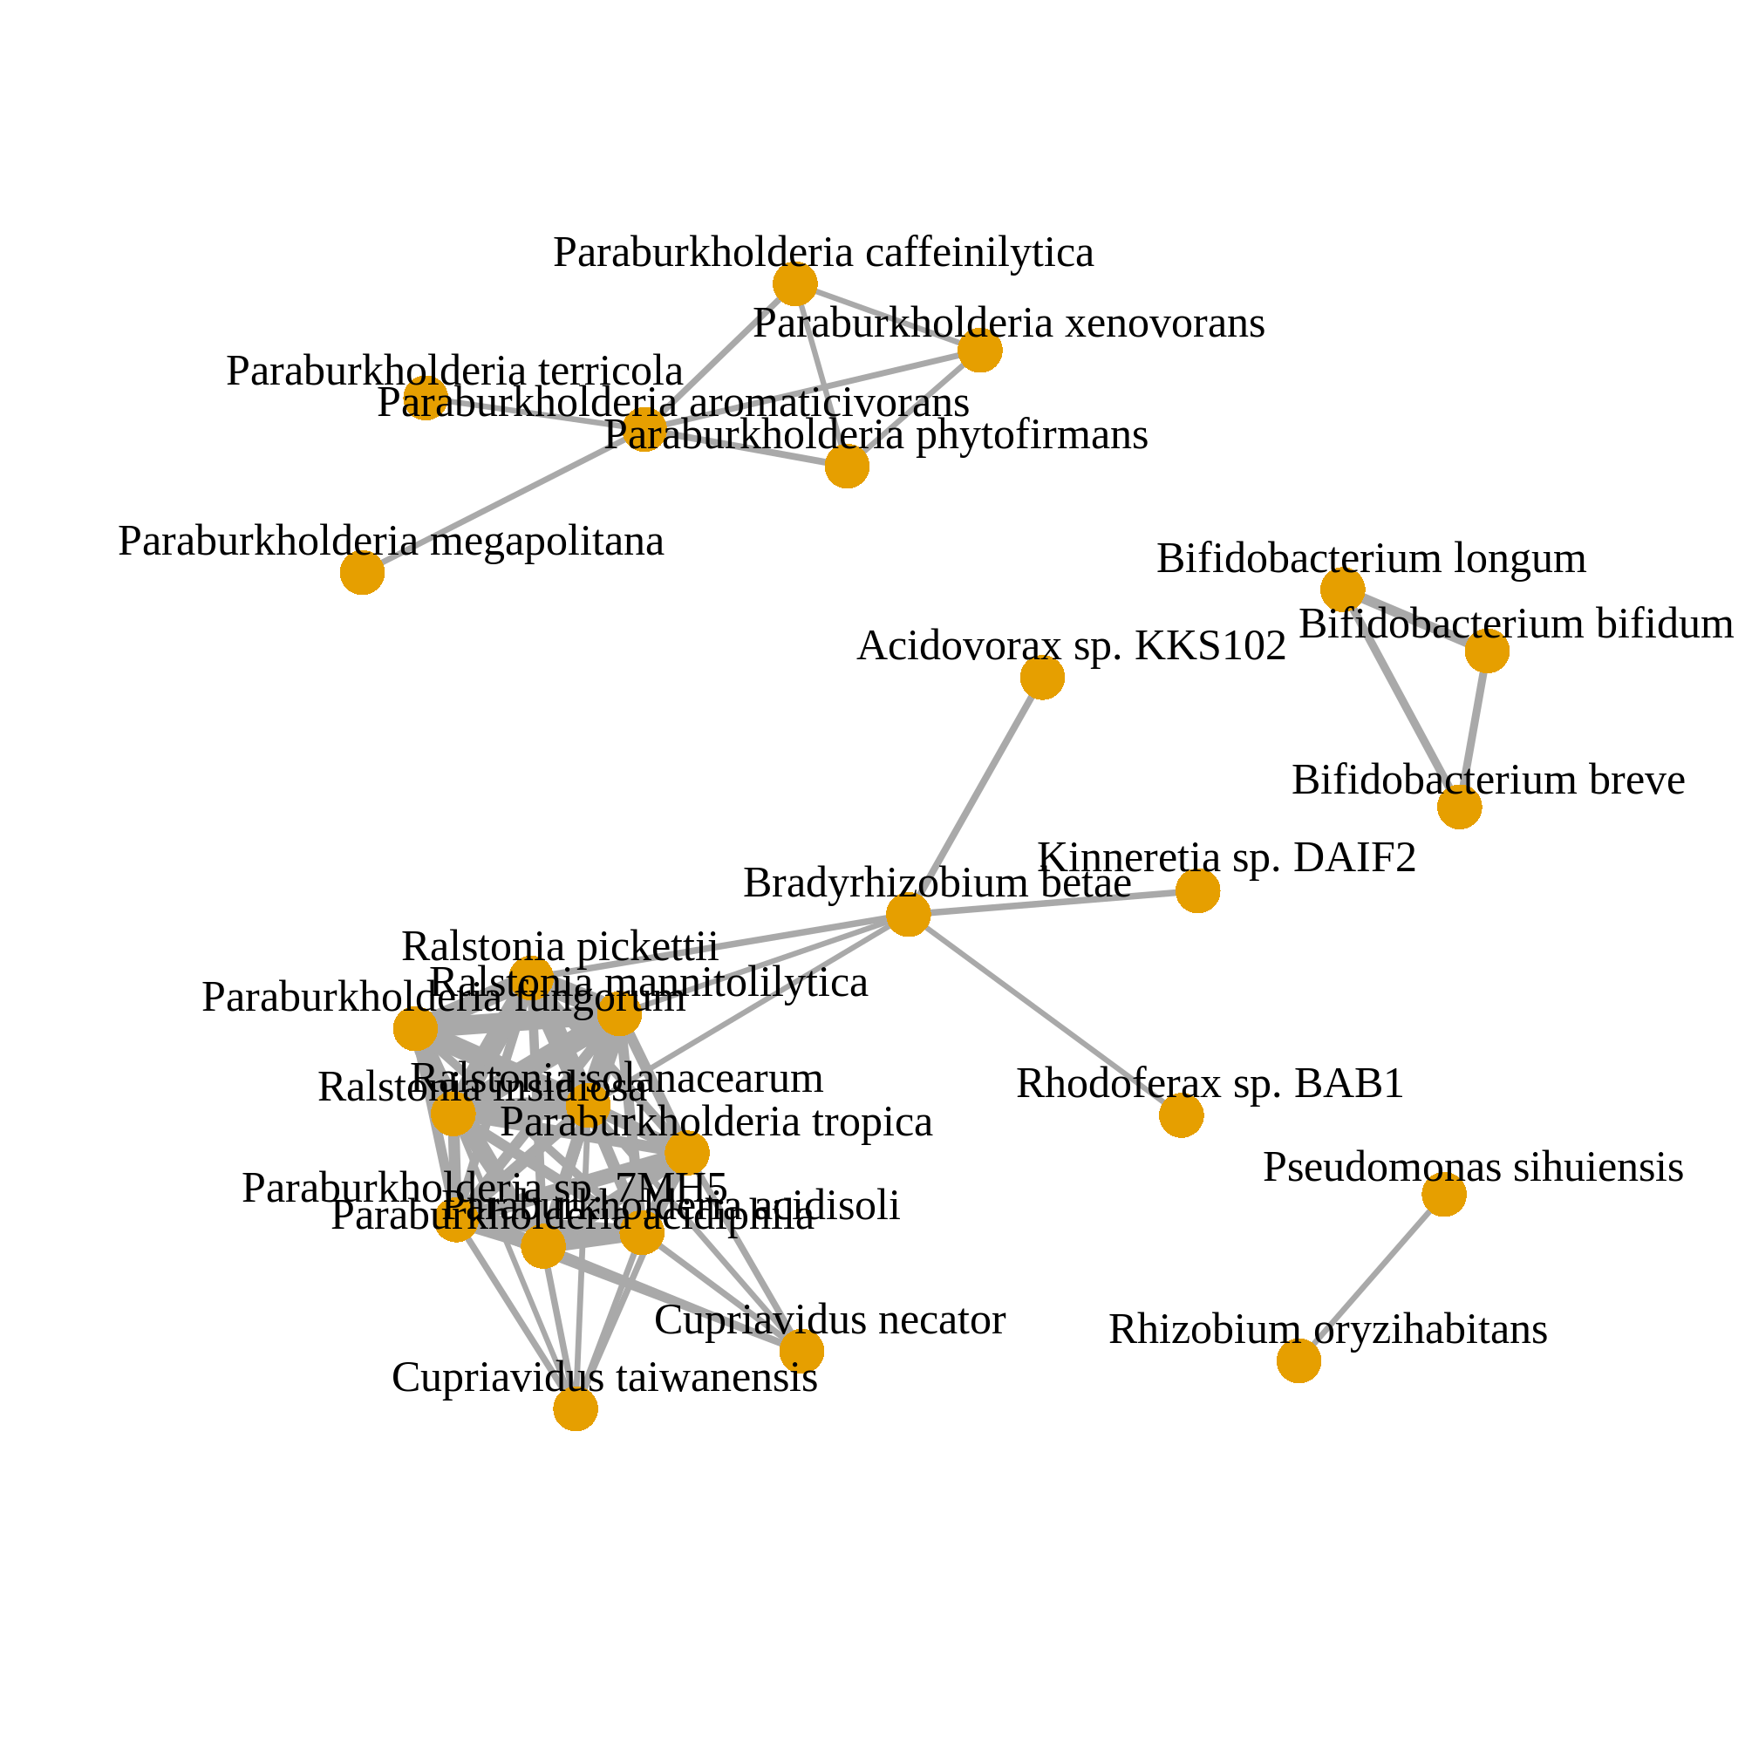
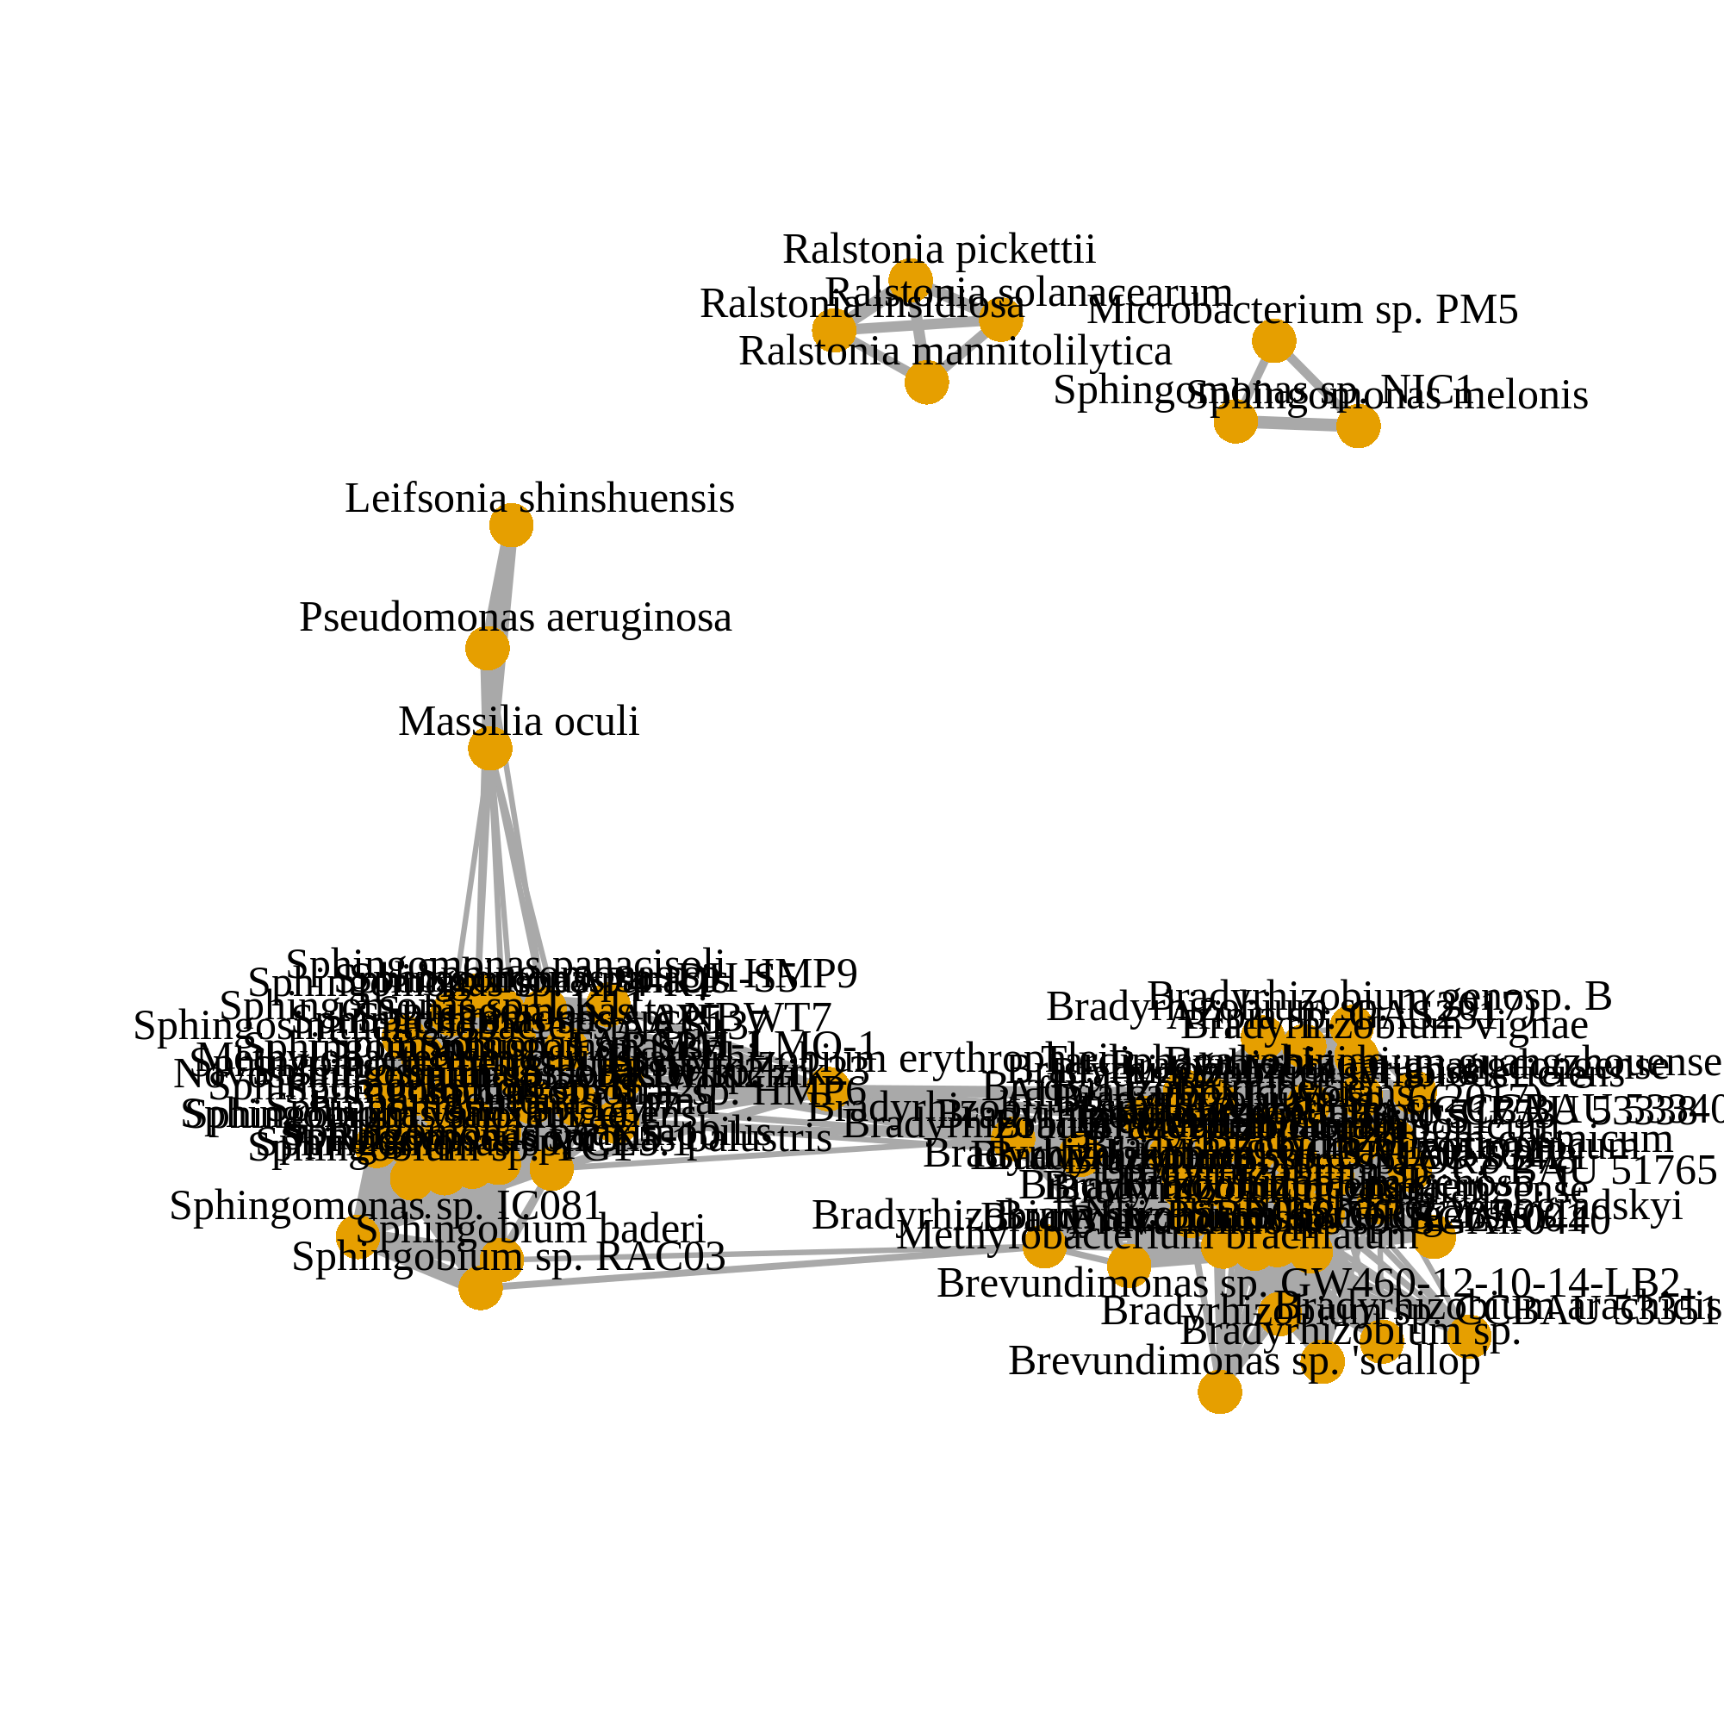
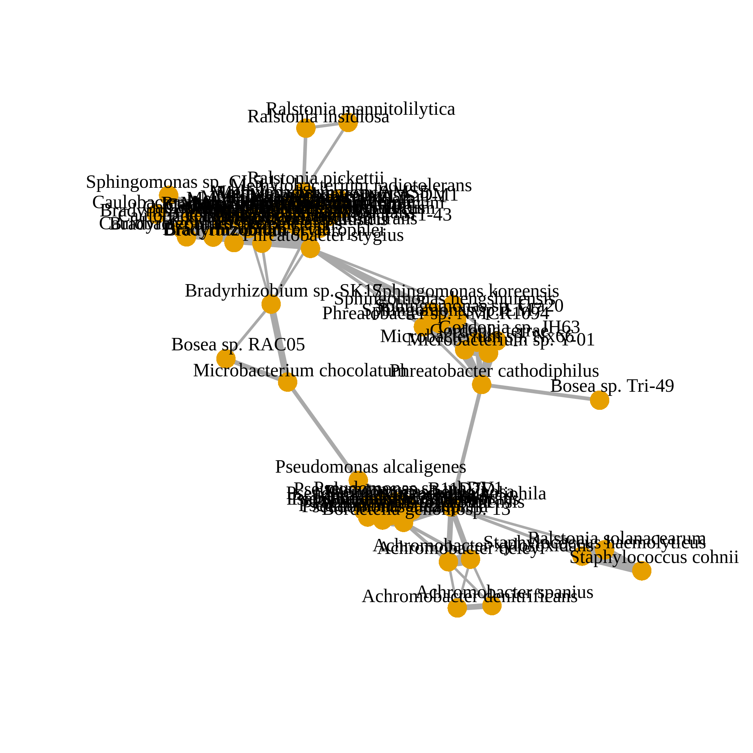
After decontamination (124 species)
(a)
Corr. > 0.05
Corr. > 0.1
Corr. > 0.2
n = 1612
Before decontamination (871 species)
(b)
Corr. > 0.2
HELIOS (n = 2284)
TTSH (n = 653)
SERI (n = 835)
MEC (n = 2713)
PRISM (n = 1248)
Intersection
No associations
Notes:
Figure 3

Slide 5
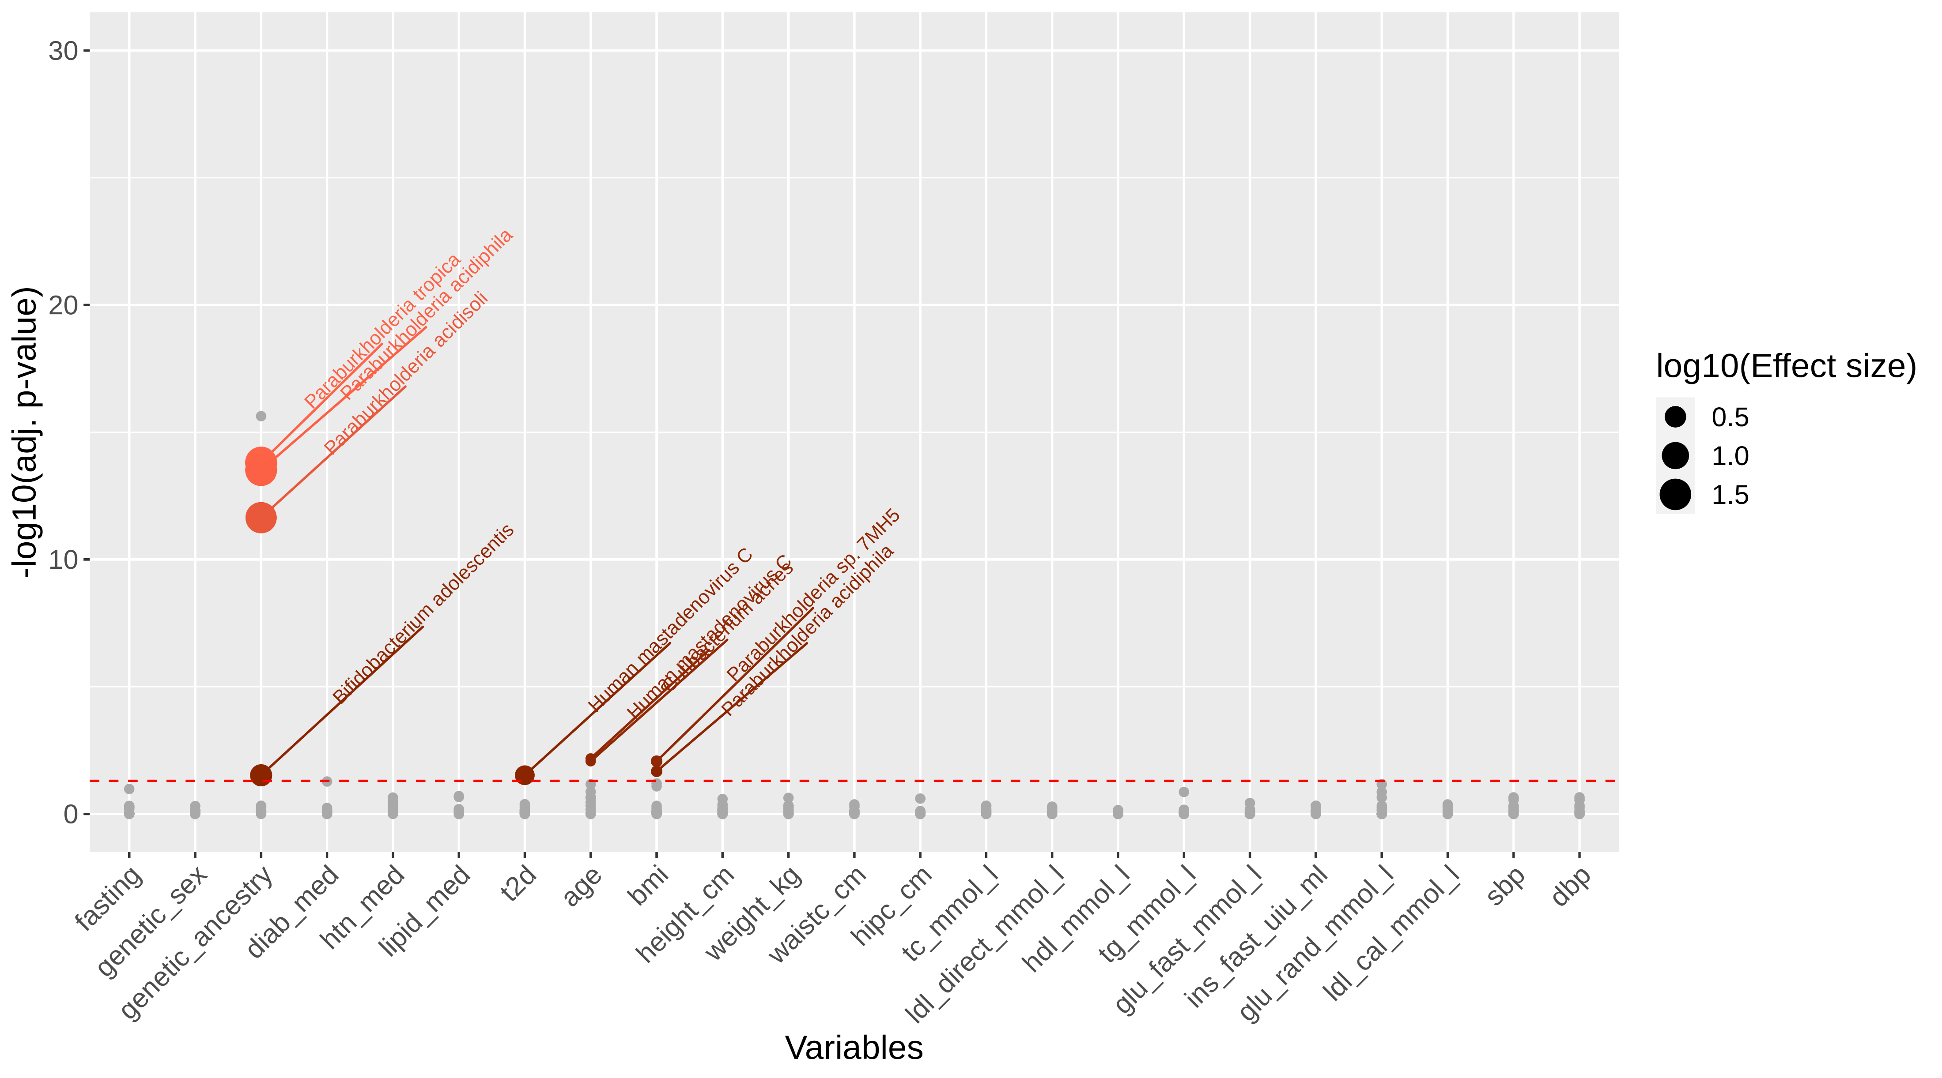
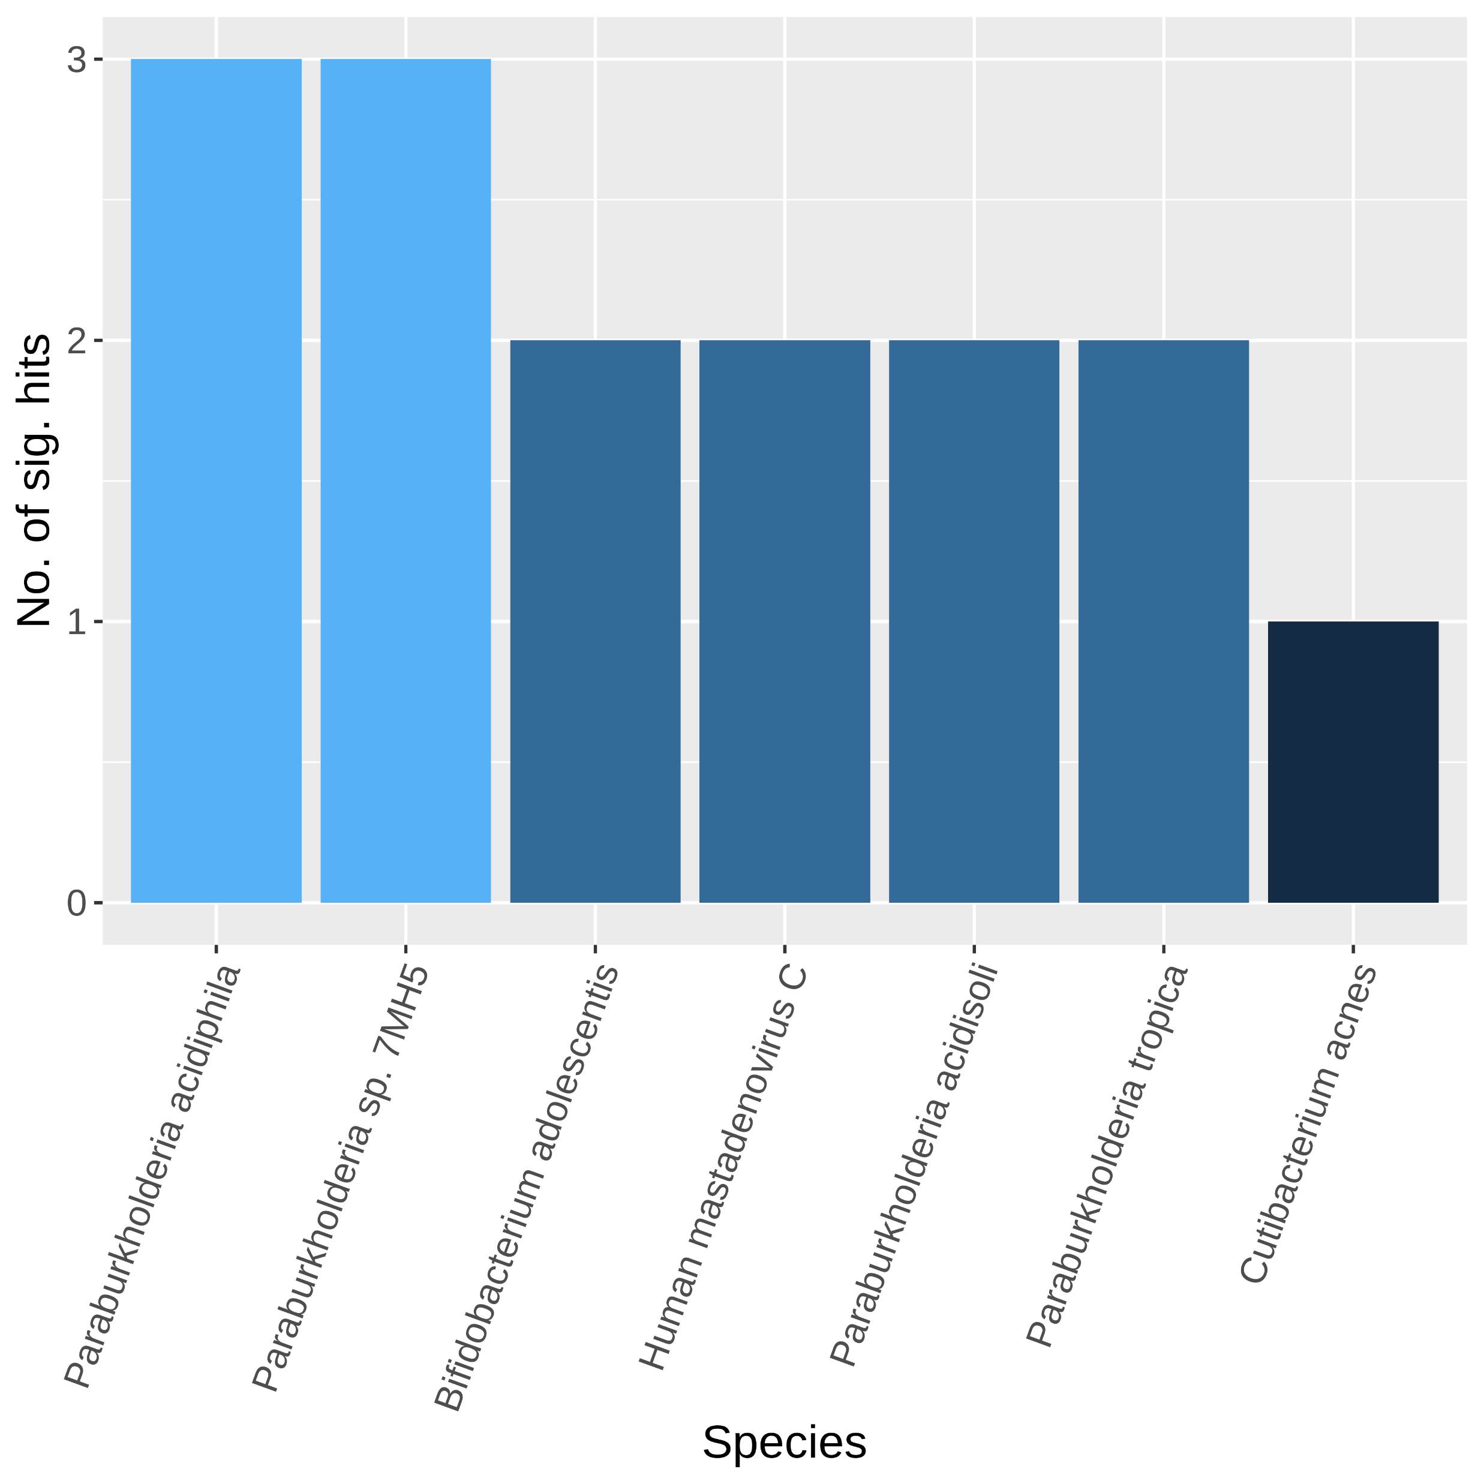
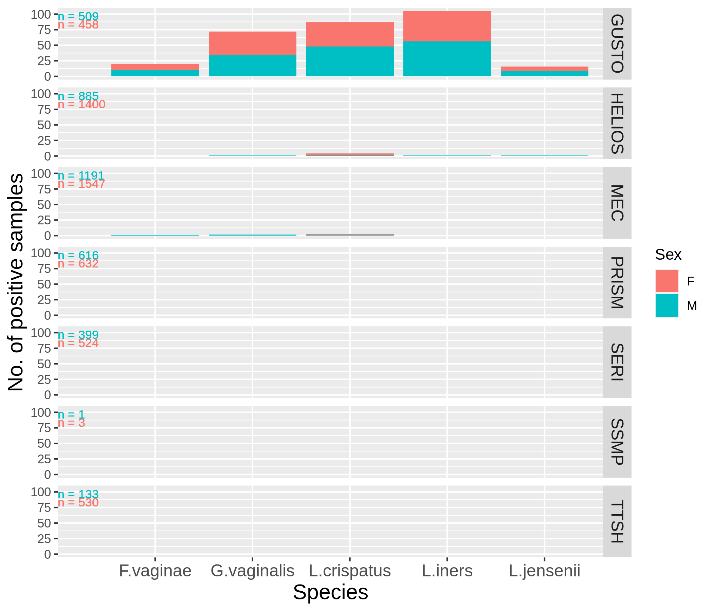
Effect of host phenotype
(a)
Presence of species, S
$ln⁡(odds({Presence}_{S}))=β_{0}+α_{cohort}+ γ_{variable}$ $+$ ε
Effect of cohort as covariate
(b)
(c)
Notes:
Figure 4
Check paraburkholderia
Check bias of each column with cohorts
Substratify species

Slide 6
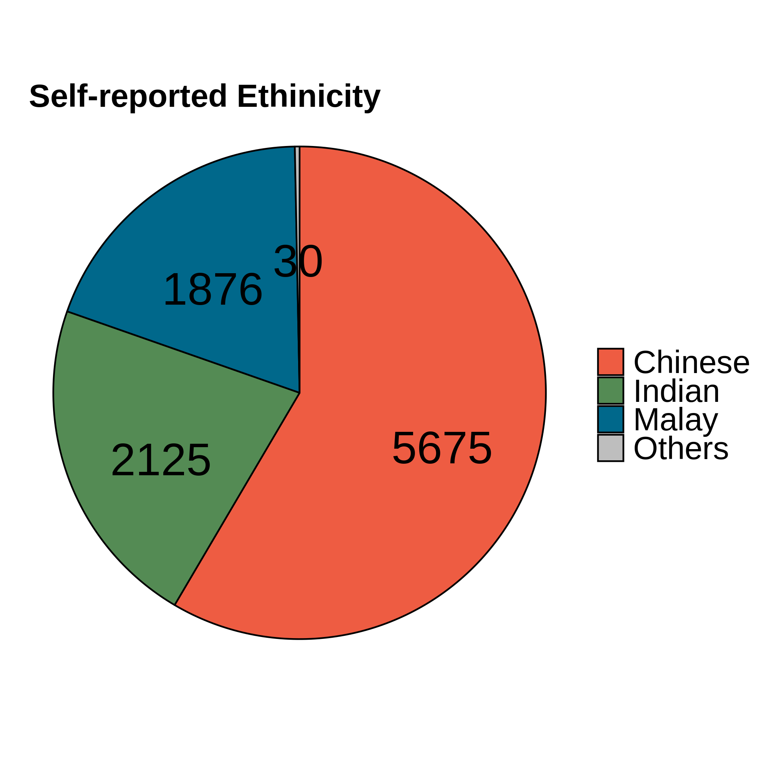
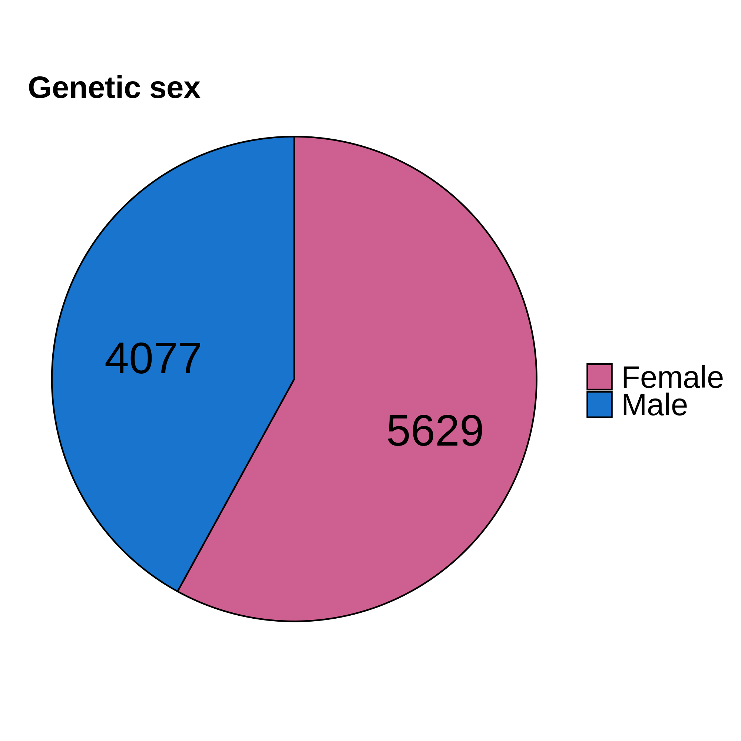
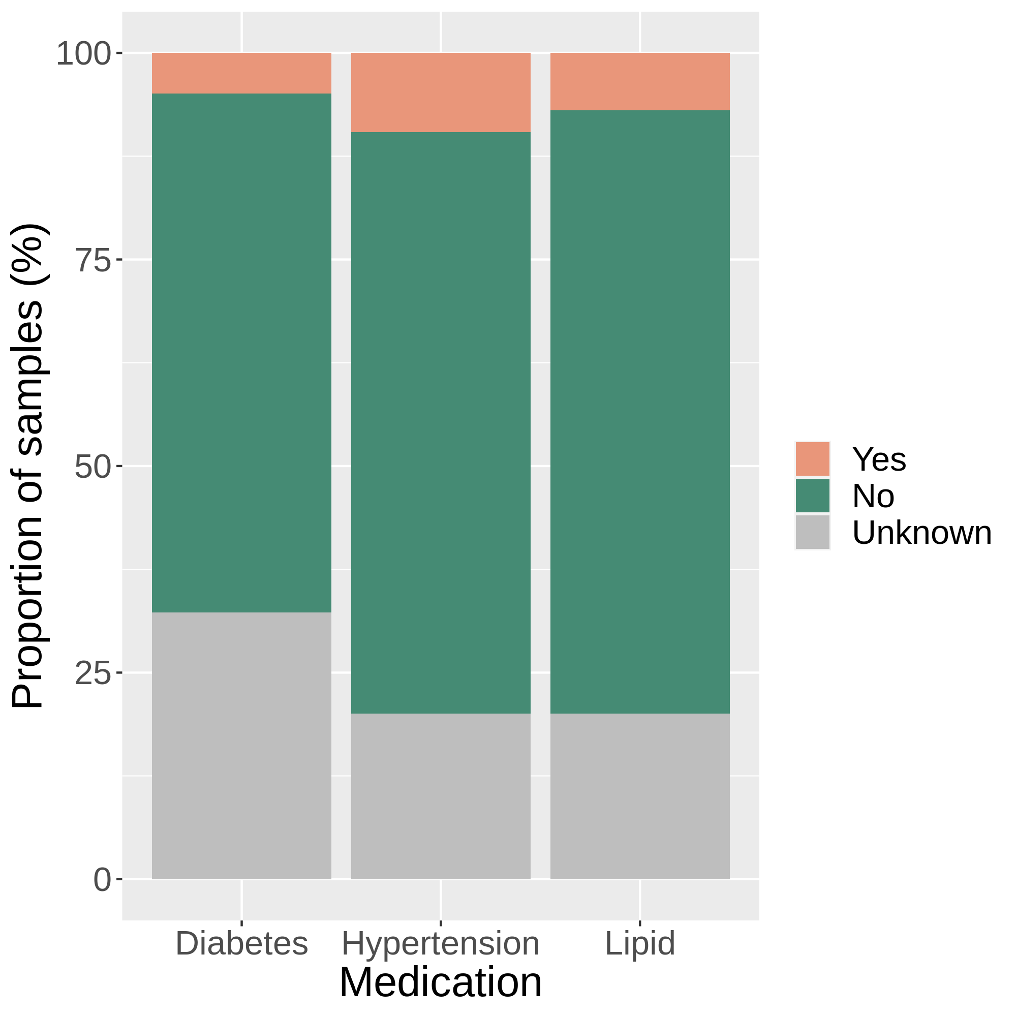
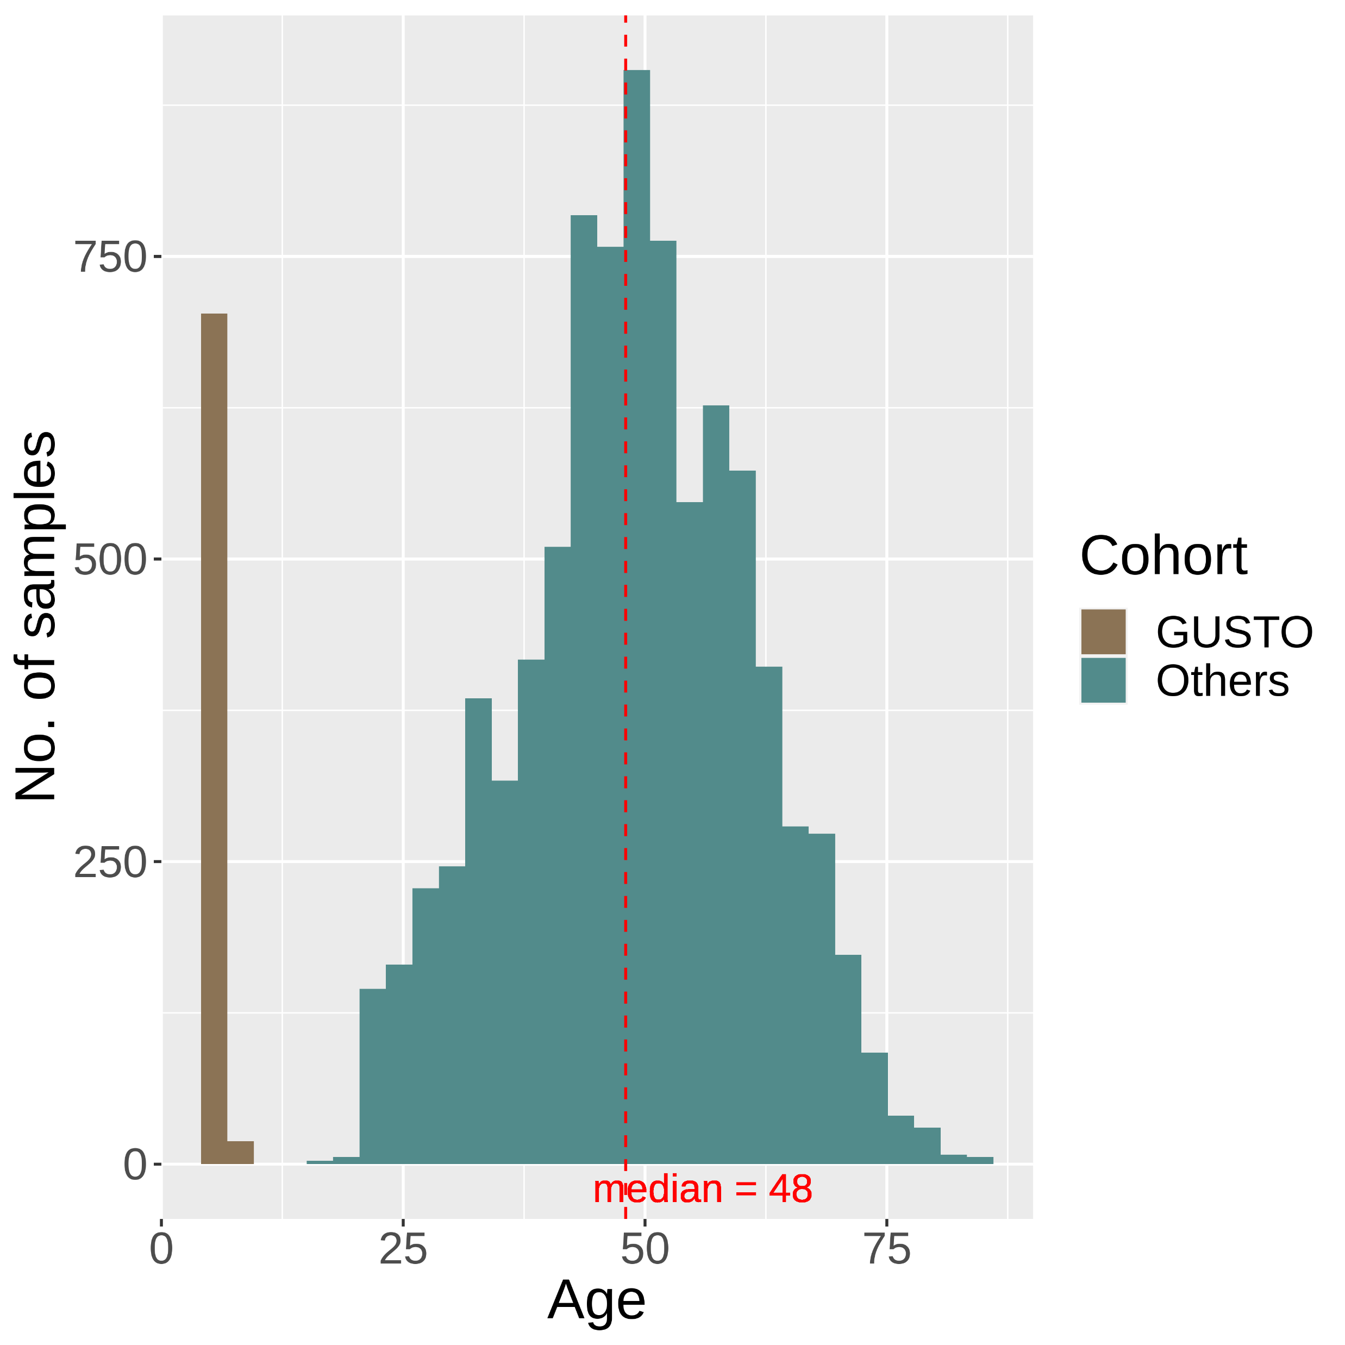
(a)
(b)
(c)
(d)
Notes:
Figure S1

Slide 7
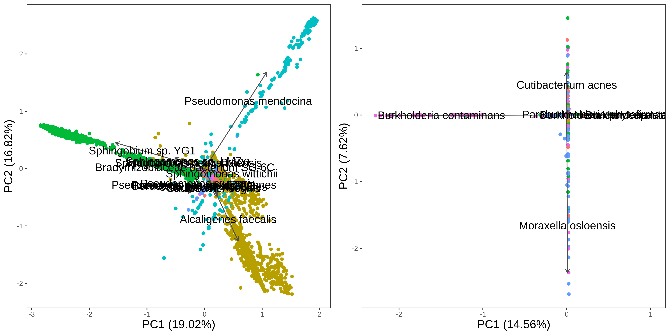
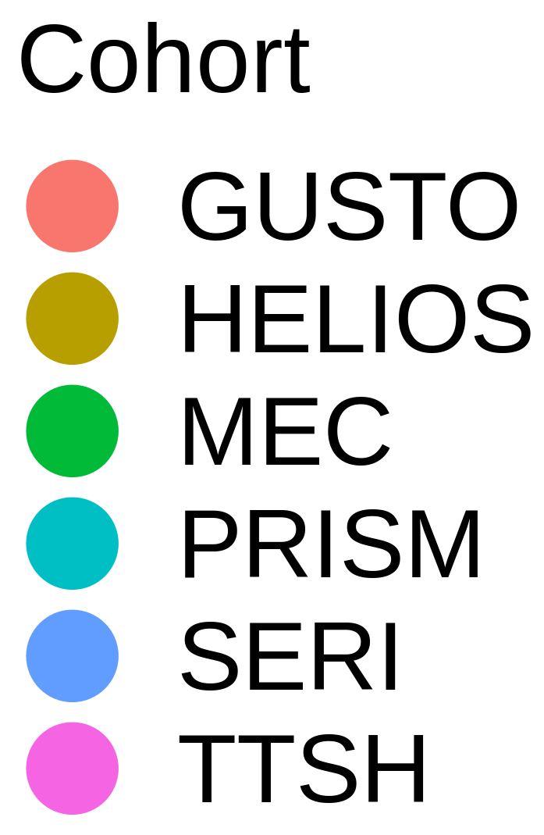
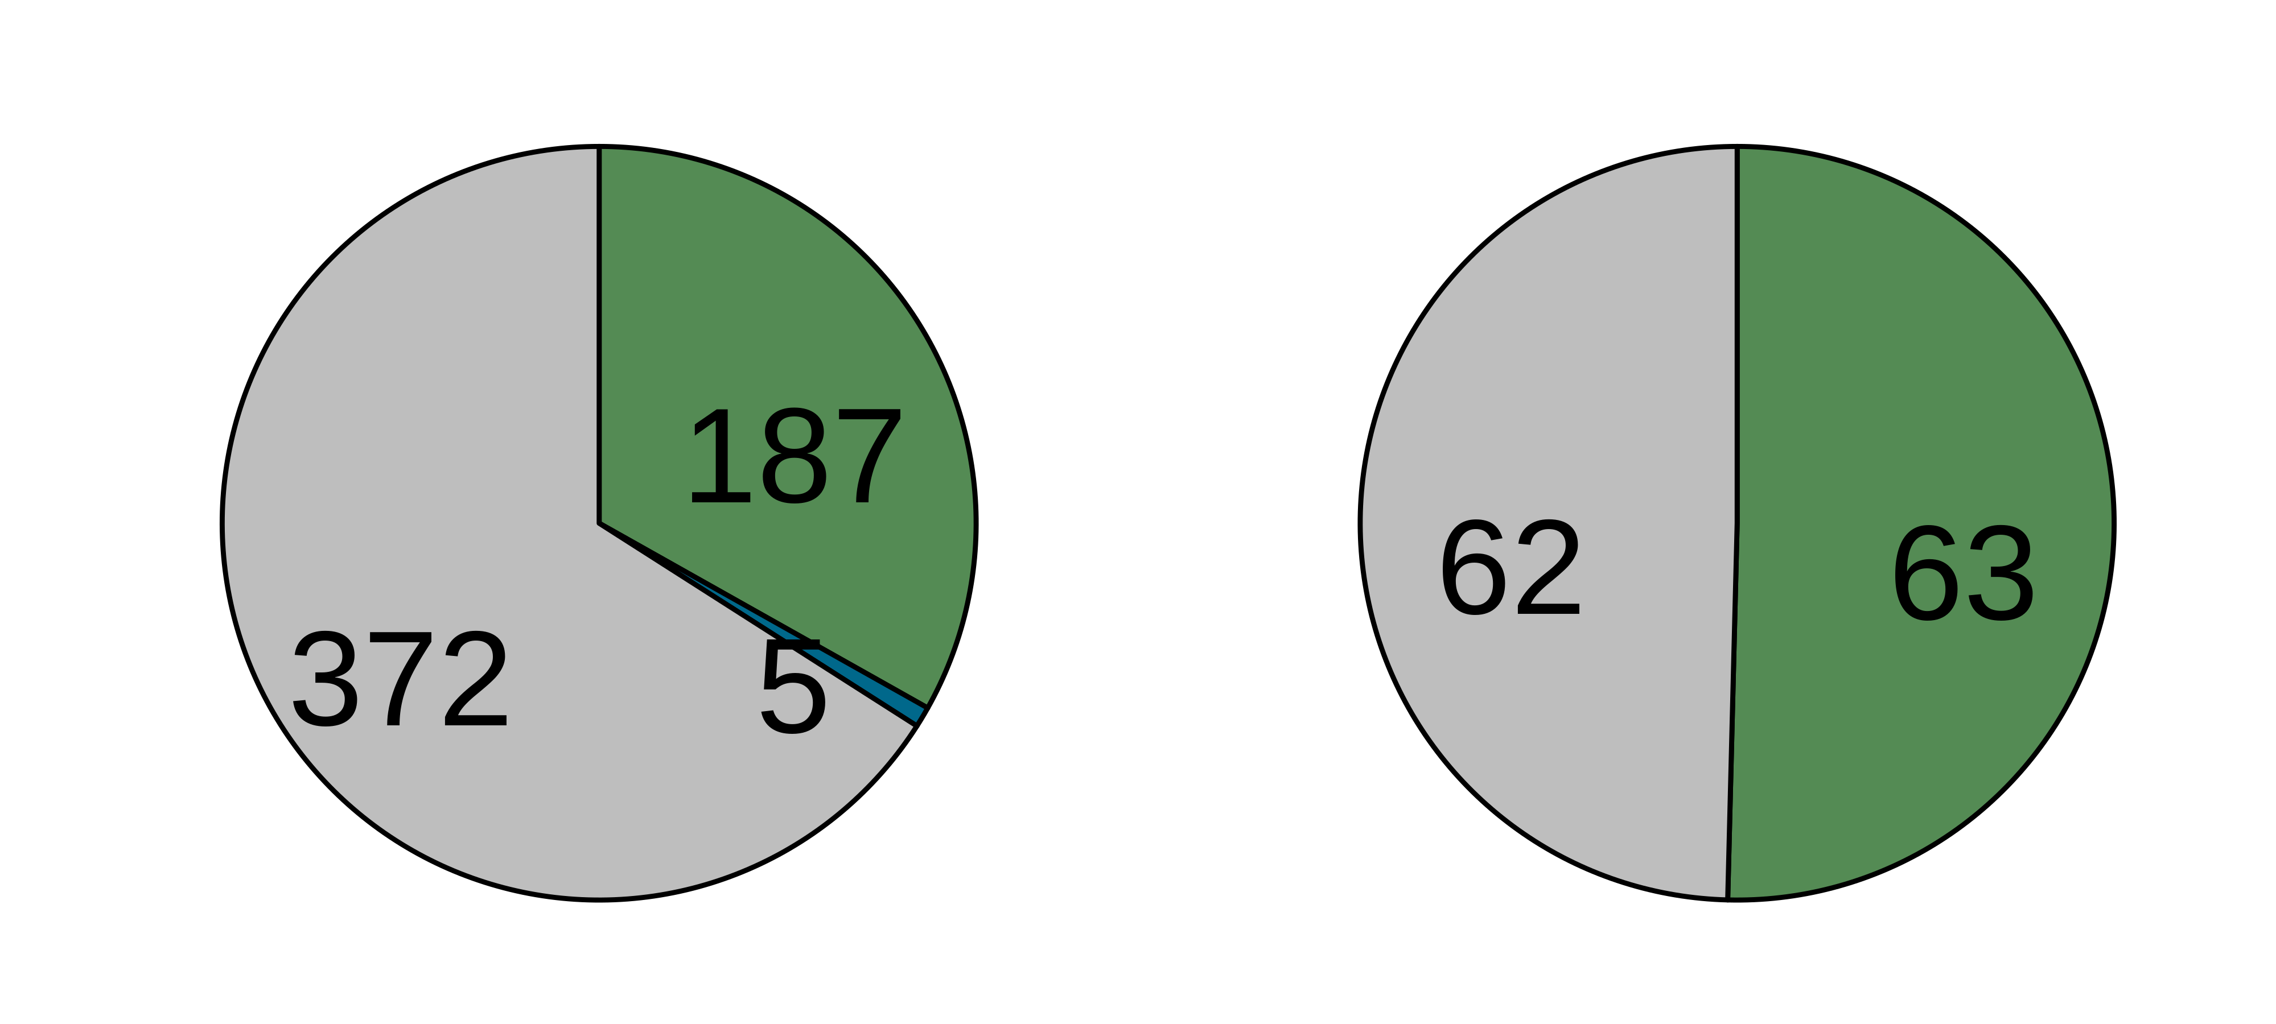
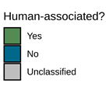
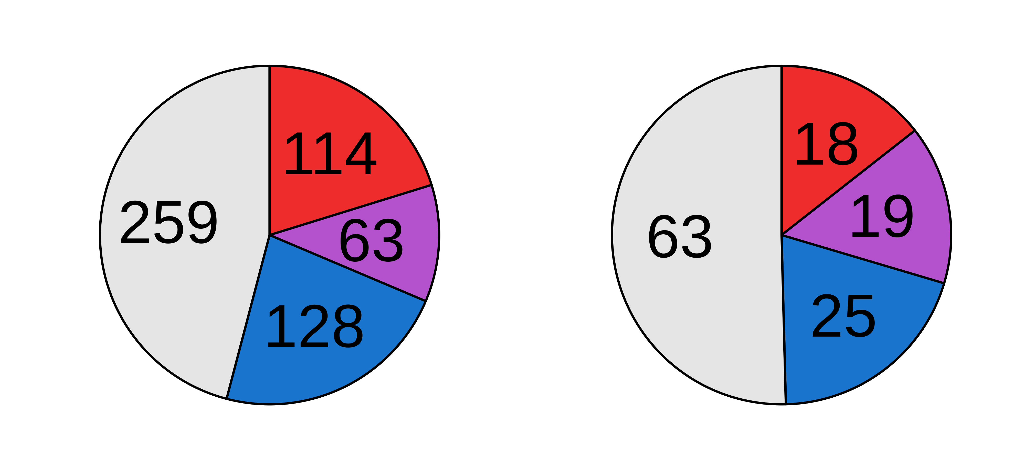
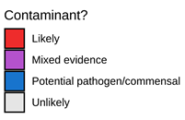
Before decontamination
After decontamination
(a)
(b)
(c)
(d)

Slide 8
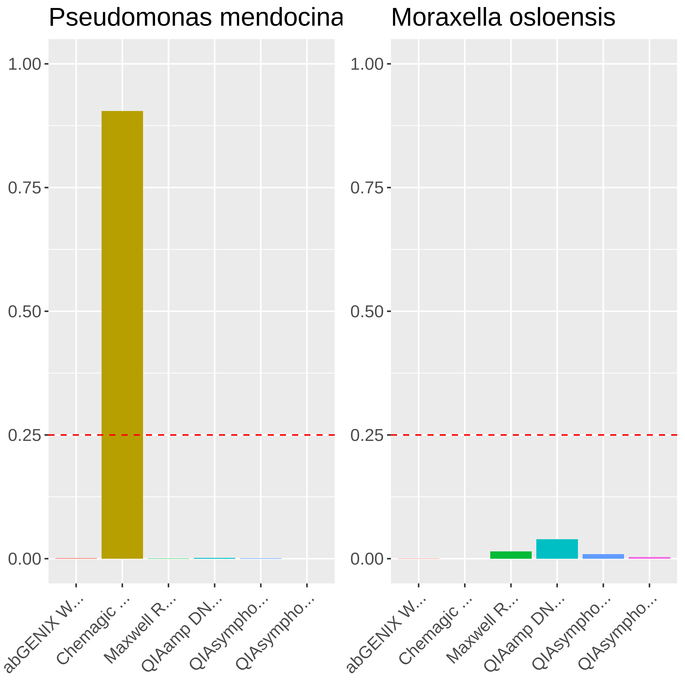
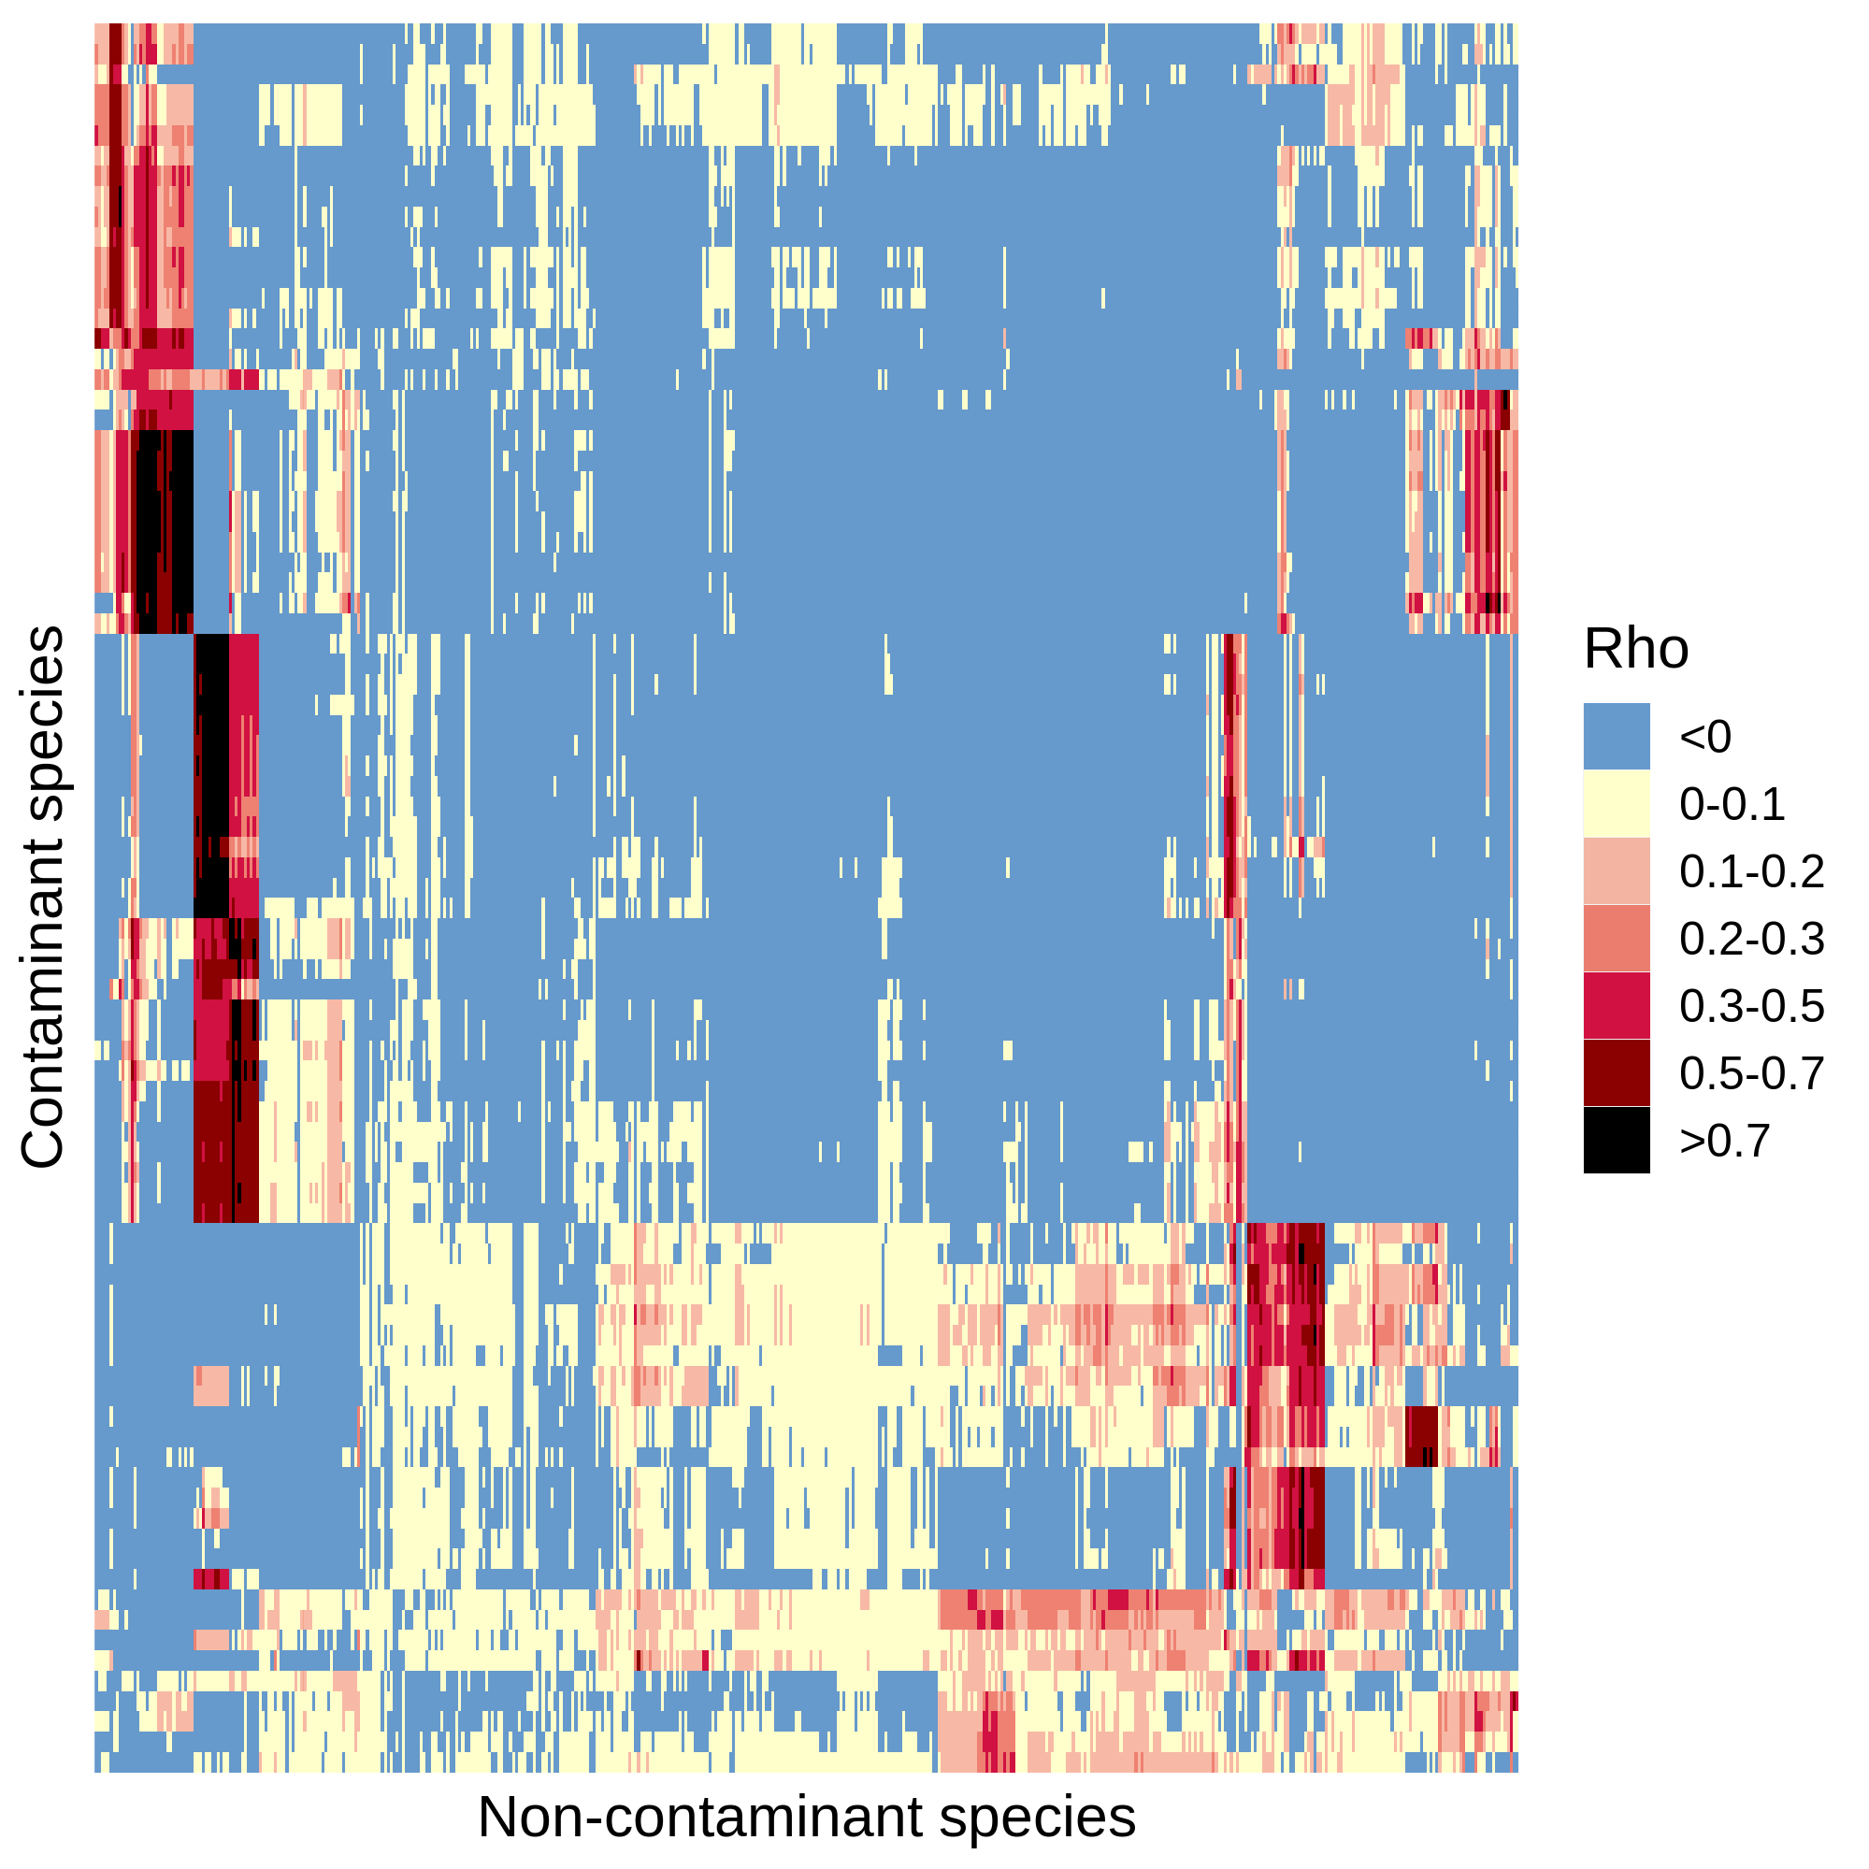
5199 species
(a)
Pre-processed Fastqs (n = 9706)
Kraken2 classification
Apply abundance thresholds
564 species
(b)
Contaminant
Non-contaminant
Filter 1
> 2-fold
Differential prevalence
478 species
(c)
Filter 2
Correlation
434 species
Filter 4
Filter 3
Downstream analyses
Max read count filter
Batch filter
176 species
125 species

Slide 9
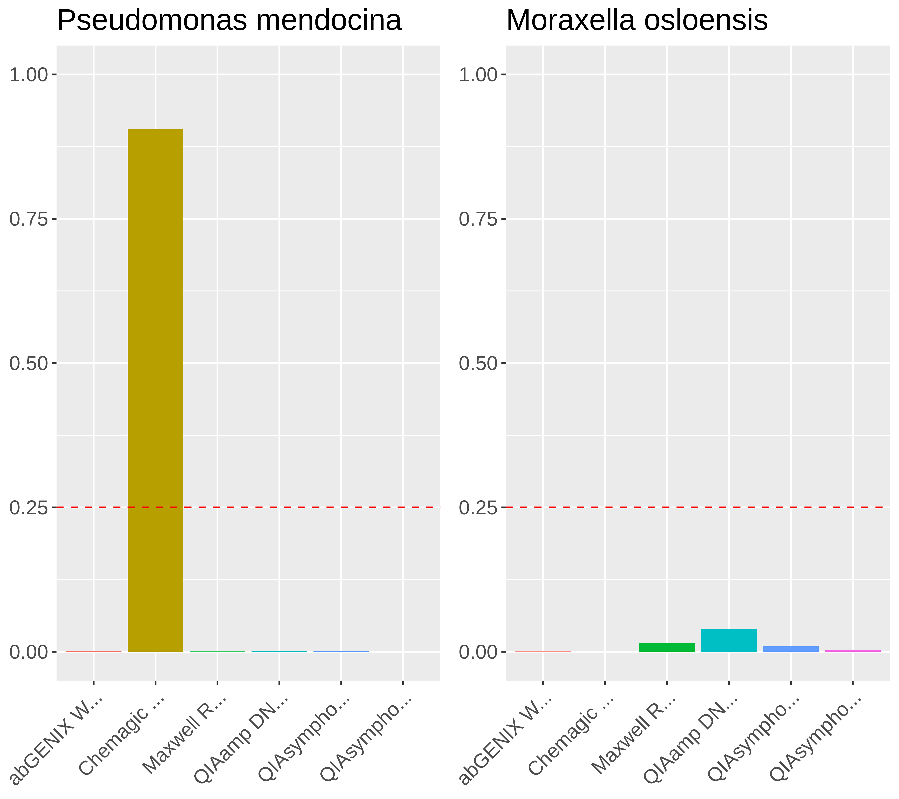
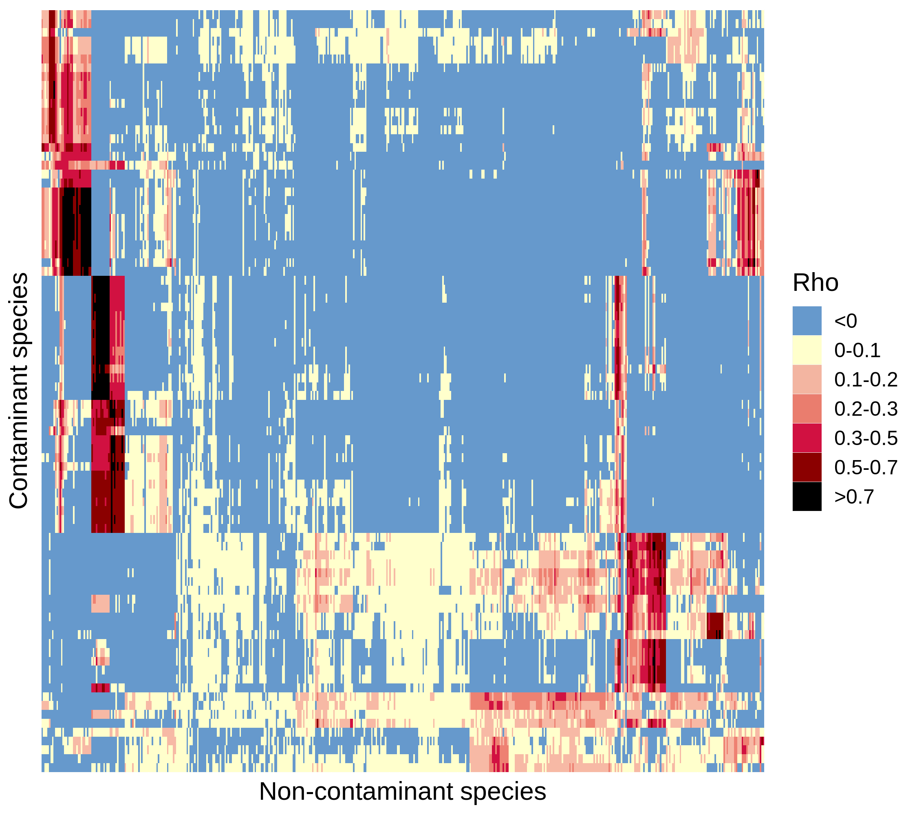
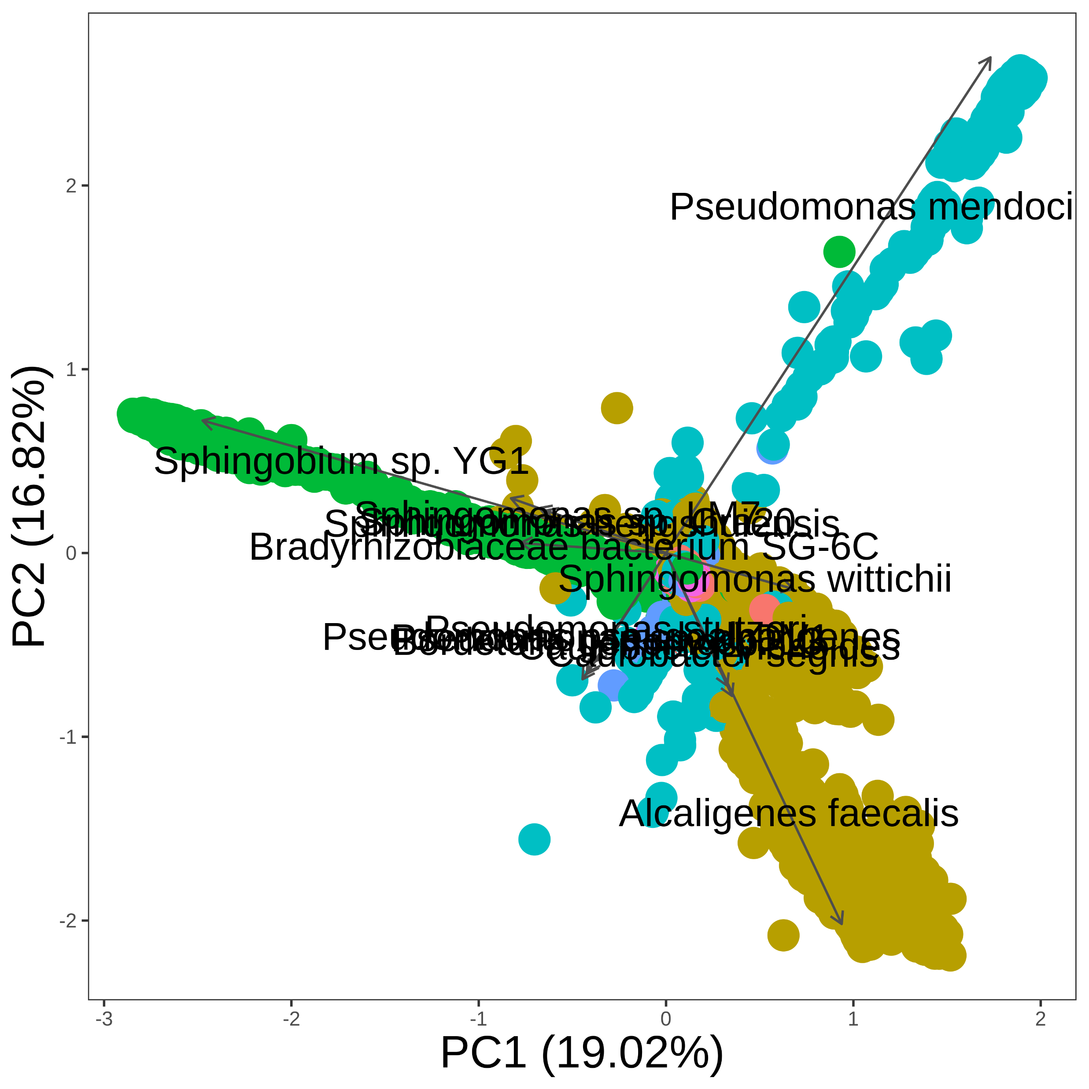
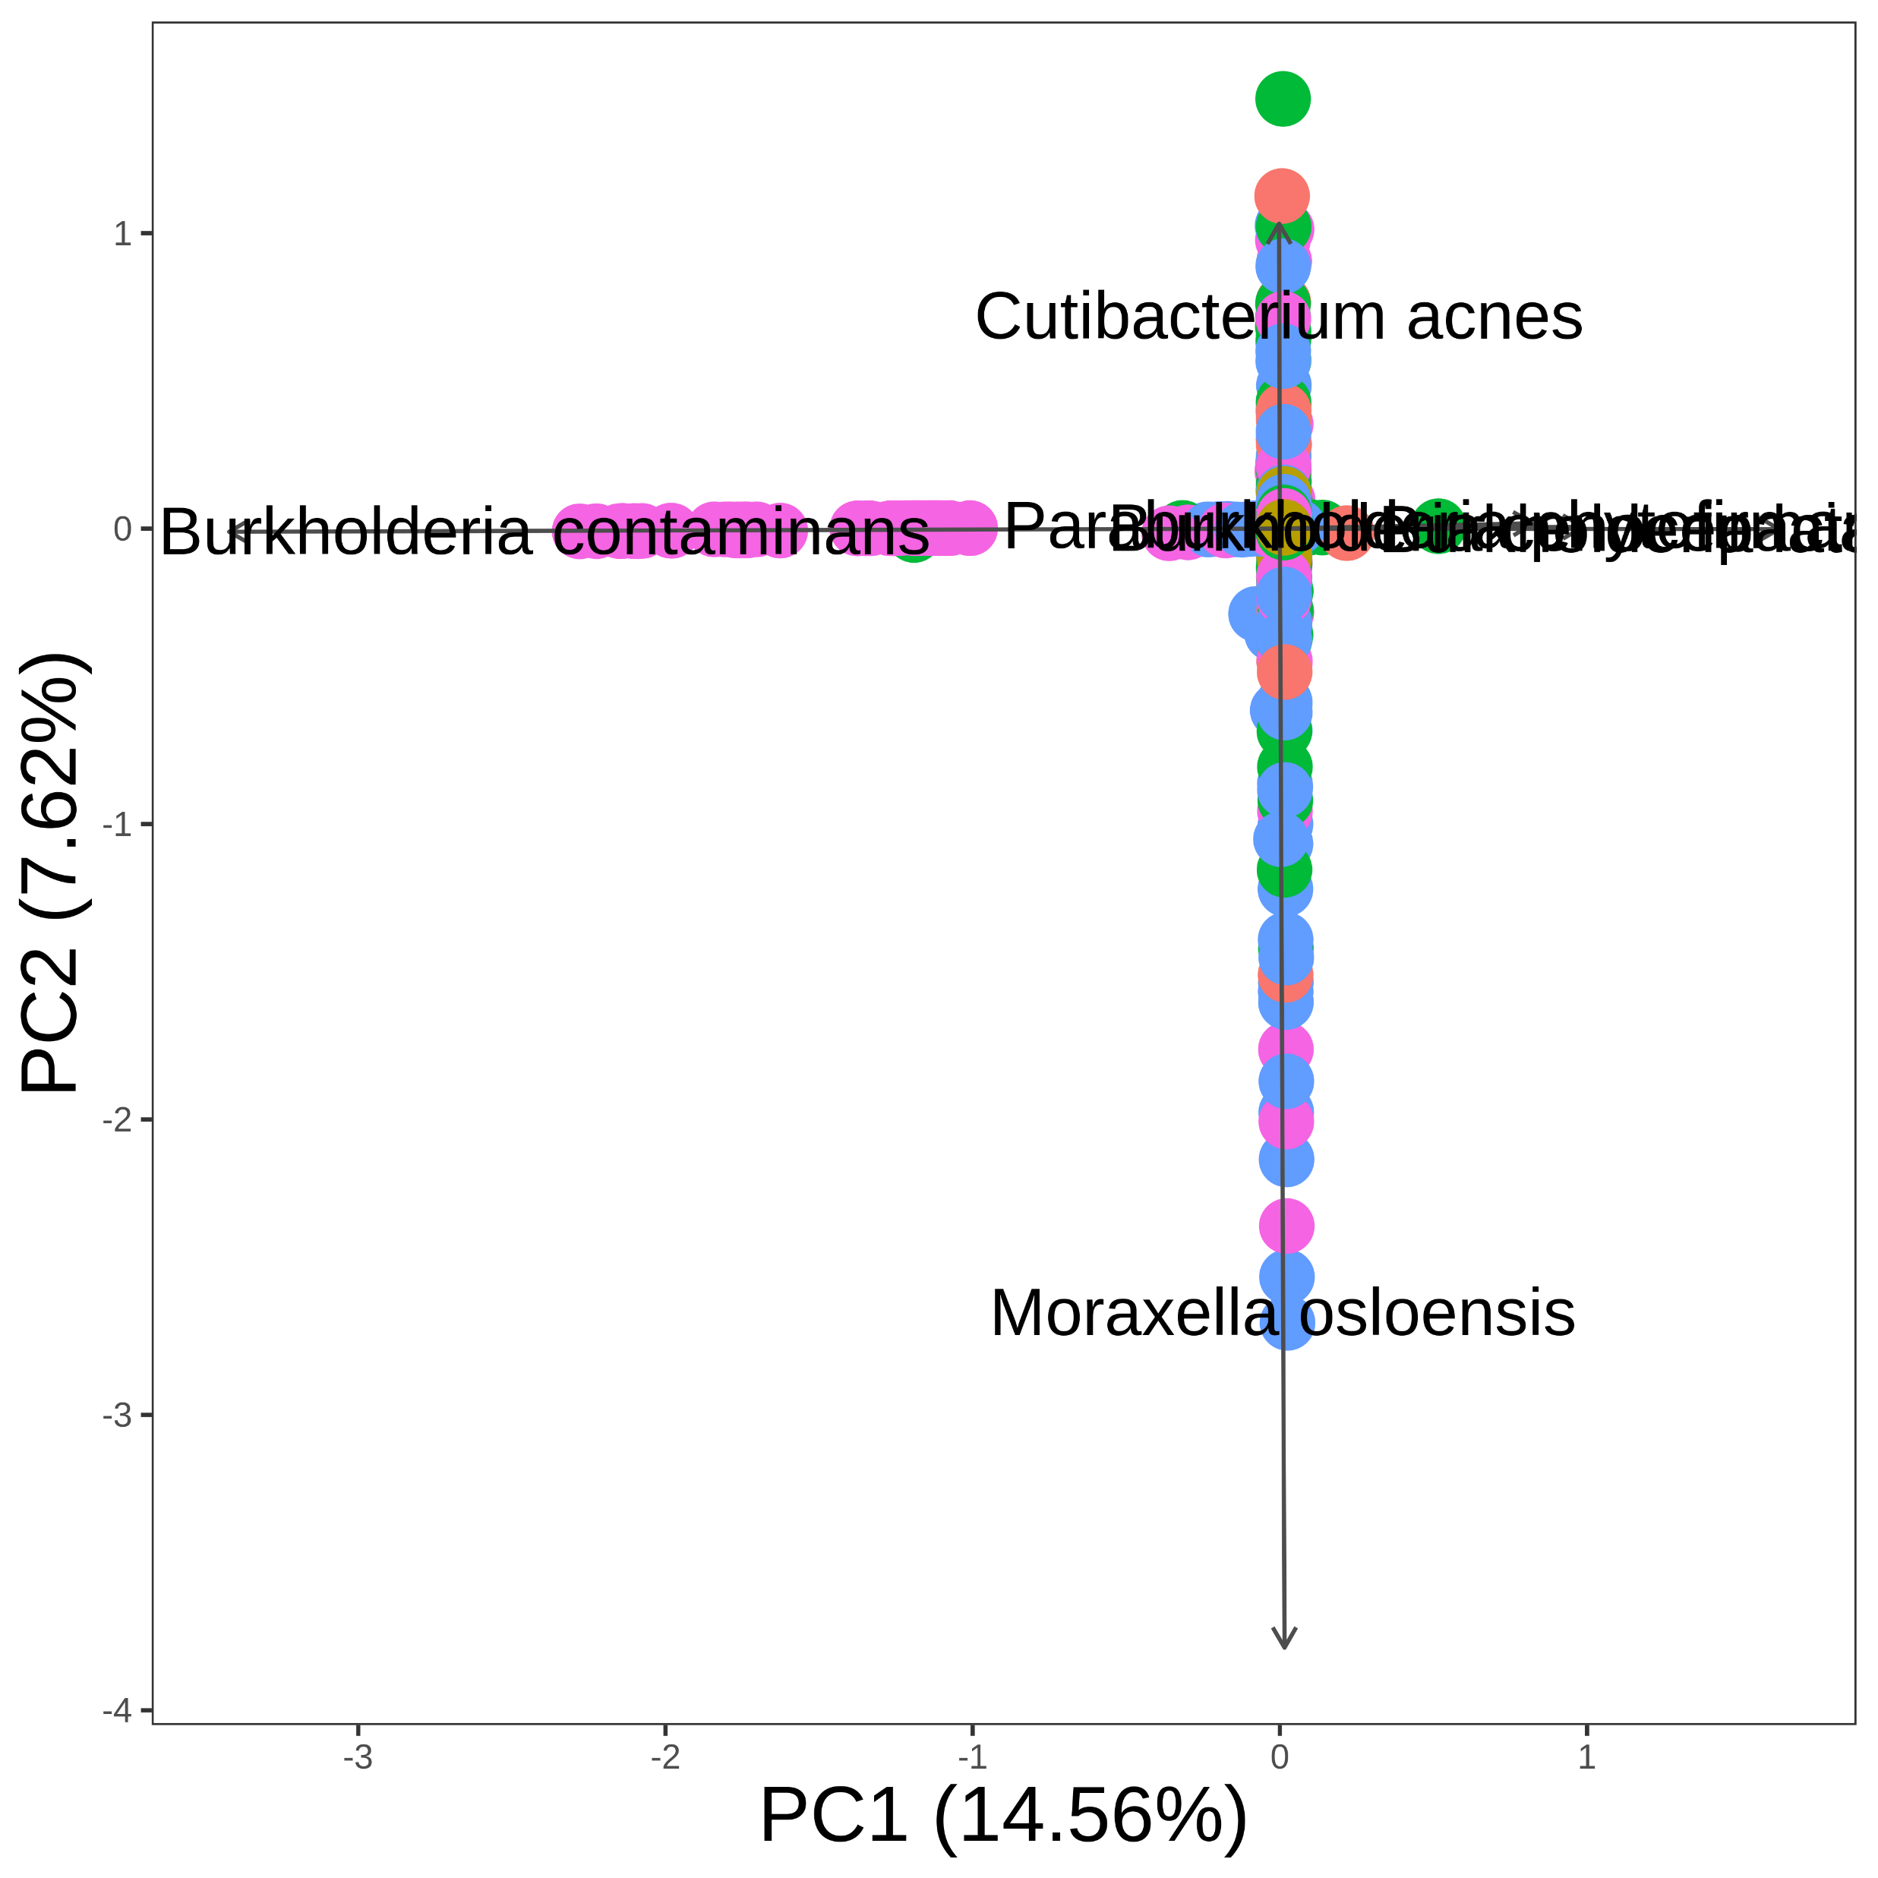
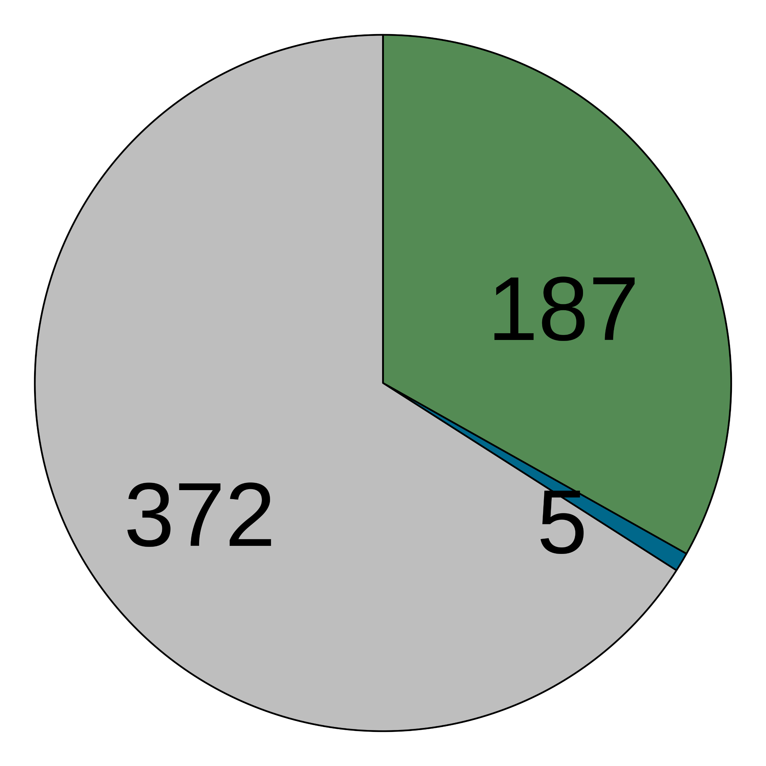



(a)
Pre-processed fastqs (n = 9706)
Kraken2 classification
Apply abundance thresholds
5199 species
564 species
Filter 1
Filter 2
Filter 3
Filter 4
Differential prevalence
Correlation
Batch filter
Max read count filter
Downstream analyses
478 species
434 species
176 species
125 species
(b)
Contaminant
Non-contaminant
(c)
> 2-fold
Before decontamination
After decontamination
(d)
(e)
(f)
(g)

